Slide 1
Isticmaalka saamiga sine (sine ratio)
Trigonometry (Trigonometry)

Slide 2
Sida agabkeena waxbarista loogu talagalay fasalka

Slide 3
Waxaan isticmaali karaa saamiga sine (sine ratio) si aan u helo dhinaca ama xagasha maqan ee saddexagalka qumman (right-angled triangle).

Slide 4
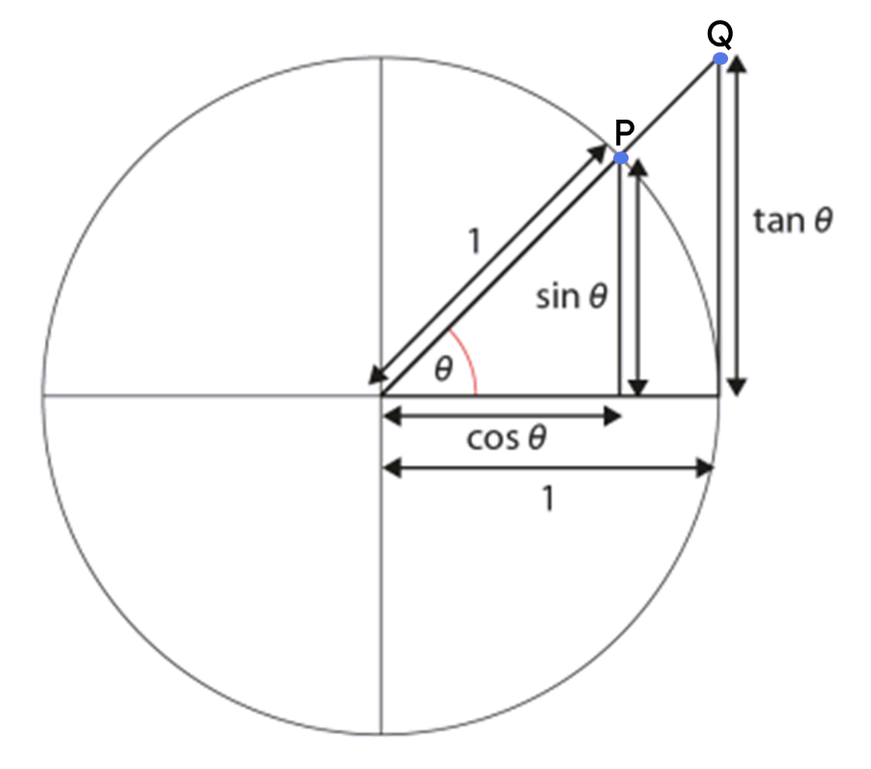
Hypotenuse (hypotenuse) waa dhinaca saddexagalka qumman (right-angled triangle) ee ka soo horjeeda xagasha qumman.
Dhinaca ka soo horjeeda (opposite side) ee saddexagalka qumman (right-angled triangle) waa dhinaca ka soo horjeeda xagasha calaamadeysan.
Hawlaha trigonometric (trigonometric functions) waxaa badanaa lagu qeexaa saamiga labada dhinac ee saddexagalka qumman (right-angled triangle) xagal la siiyay.
Sine-ga xagal (sin(θ°)) waa isku-duwayaasha y (y-coordinate) ee barta P ee saddexagalka ku dhex samaysmay goobada halbeegga (unit circle).

Slide 5

Isticmaalka saamiga sine (sine ratio)
Qaabaynta qaacidada sine (sine formula)
Xisaabinta xaglaha iyadoo la isticmaalayo qaacidada sine (sine formula)

Slide 6
Qaabaynta qaacidada sine (sine formula)
Waxaan ognahay in labadan saddexagal ay isku mid yihiin (similar), sababtoo ah laba xagal oo ka mid ah saddexagalka ayaa la mid ah laba xagal ee kan kale.
Waxaan heli karnaa dhererka dhinaca lagu calaamadeeyay x adigoo isticmaalaya jaantuska saamiga (ratio table).
× 0.67
1
0.67
× 12
× 12
12
0.67 × 12
× 12
8.04
× 0.67
12 cm
8.04 cm
x cm
1 cm
0.67 cm
42°
42°

Slide 7
Qaabaynta qaacidada sine (sine formula)
Waxaan kaloo guudmarin karnaa habkan oo dhan saddex-xagal kasta oo qumman oo leh xagal θ°, halkaas oo dhinaca ka soo horjeeda θ° uu leeyahay dherer sin(θ°).
× sin(θ°)
1
sin(θ°)
× h
× h
h
h × sin(θ°)
× h
opp
× sin(θ°)
h cm
h × sin(θ°)
dhinaca ka soo horjeeda (opp)
1 cm
sin(θ°)
θ°
θ°

Slide 8
Qaabaynta qaacidada sine (sine formula)
Waxaan kaloo guudmarin karnaa habkan oo dhan saddex-xagal kasta oo qumman oo leh xagal θ°, halkaas oo dhinaca ka soo horjeeda θ° uu leeyahay dherer sin(θ°).
1
sin(θ°)
h cm
h
dhinaca ka soo horjeeda (opp)
dhinaca ka soo horjeeda (opp)
h × sin(θ°)
h × sin(θ°)
× sin(θ°)
θ°
Dhererka hypotenuse-ga (hypotenuse)
oo lagu dhuftay sine (sine) xagal θ°
wuxuu la mid yahay dhererka dhinaca ka soo horjeeda xagashaas.

Slide 9
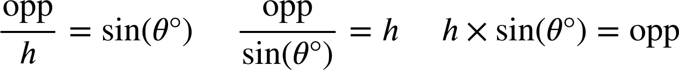
Qaabaynta qaacidada sine (Formalising the sine formula)
Waxaan u isticmaali karnaa jaantuska saamiga (ratio table) si aan u soo saarno qaacidada (formula) tusaysa xiriirka ka dhexeeya dhinaca ka soo horjeeda xagasha θ° iyo hypotenuse-ka, waxaana u matali karnaa qaacidada saddex siyaabood.
× sin(θ°)
1
sin(θ°)
sin(θ°)
× h
× h
÷ h
h
dhinaca ka soo horjeeda (opp)
h
opp
× sin(θ°)
÷ sin(θ°)
× sin(θ°)
h × sin(θ°)
h cm
dhinaca ka soo horjeeda (opposite)
θ°

Slide 10
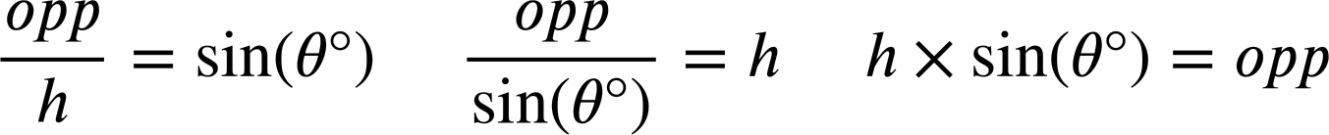
Qaabaynta qaacidada sine (Formalising the sine formula)
Waxaan sidoo kale ka soo saari karnaa laba nooc oo qaacidada ah marka la eego mid ka mid ah kuwa kale adoo sameynaya qaybin (division).

Slide 11
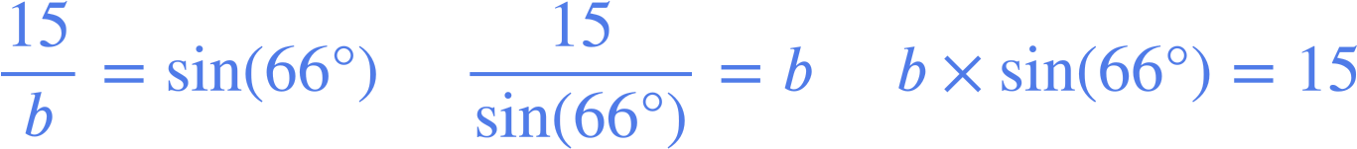
Qaabaynta qaacidada sine (Formalising the sine formula)
Waxaan ku beddeli karnaa qiimayaasha (values) saddexagal qumman (right-angled triangle) nooc kasta oo ka mid ah qaacidada sine si aan u matallo xiriirka ka dhexeeya dhinaca ka soo horjeeda xagasha iyo hypotenuse-ka siyaabo kala duwan.
b cm
15 cm
66°

Slide 12



Qaabaynta qaacidada sine (Formalising the sine formula)
Kee ayaa si sax ah u tusaya xiriirka ka dhexeeya hypotenuse-ka iyo dhinaca ka soo horjeeda xagasha 82° ee saddexagalkan (lagu soo koobay tirada ugu dhow)?
a
d
100 cm
99 cm
b
e
82°
c

Slide 13
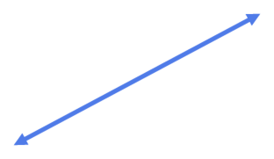
Qaabaynta qaacidada sine (sine formula)
Kee ayaa si sax ah u muujinaya xiriirka ka dhexeeya hypotenuse-ka iyo dhinaca ka soo horjeeda xagasha θ° ee saddexagalkaan (lagu soo wareejiyay tirada ugu dhow)?
a
89 cm
d
b
θ°
e
116 cm
c

Slide 14
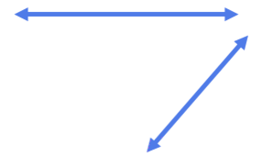
Qaabaynta qaacidada sine (sine formula)
1) Ku beddel dhinacyada la calaamadeeyay iyo xagasha saddexagal kasta labadan nooc ee qaacidada sine (sine formula).
Saddexagal kasta, dooro nooca ugu habboon ee qaacidada sine (sine formula) si aad u hesho dhererka dhinaca maqan.
× sin( ) =
× sin( ) =
119
b cm
49°
119 cm
81°
2 cm
=
=
sin( )
sin( )
a cm

Slide 15

Qaabaynta qaacidada sine (sine formula)
2) Isku dhig saddexagalka iyo isla'egta muujinaysa xiriirka ka dhexeeya hypotenuse-kiisa iyo dhinaca ka soo horjeeda.
U isticmaal isla'egta si aad u hesho dhererka dhinaca maqan ee lagu calaamadeeyay x ee saddexagal kasta (2 d.p.)
a)
b)
c)
50 cm
32 cm
x cm
50°
32°
x cm
32°
x cm
50 cm
x × sin(32°) = 50
d
50 × sin(32°) = x
e
32 × sin(50°) = x
f

Slide 16
Qaabaynta qaacidada sine (sine formula)
3) Adigoo isticmaalaya qaacidada sine (sine formula), hel dhererka dhinaca maqan ee ku calaamaysan xaraf saddexagal kasta (2 d.p.)
a)
b)
c)
1 cm
14.9 cm
14.9 cm
a cm
b cm
c cm
39°
39°
49°
d)
e)
f)
d cm
e cm
41°
f cm
14.9 cm
49 cm
49°
49°
14.9°
14.9 cm

Slide 17
Qaabaynta qaacidada sine (sine formula)
4) Hel dhererka masaafada a, b, c, iyo d (oo lagu soo wareejiyay tirada ugu dhow).
d cm
10 cm
b cm
64 cm
50 cm
c cm
39.5 cm
a cm
27°

Slide 18
Qaabaynta qaacidada sine (sine formula)
1) Ku beddel dhinacyada iyo xagasha la calaamadeeyay ee saddexagal kasta labadan nooc ee qaacidada sine (sine formula).
Saddexagal kasta, dooro nooca ugu habboon ee qaacidada sine (sine formula) si aad u hesho dhererka dhinaca maqan.
× sin( ) =
× sin( ) =
119
81°
a
b
49°
2
b cm
49°
a
119 cm
2
81°
2 cm
119
b
=
=
sin( )
sin( )
81°
49°
a cm = 117.53 cm
b cm = 2.65 cm
a cm

Slide 19
Qaabaynta qaacidada sine (sine formula)
2) Isku dhig saddexagalka iyo isla'egta muujinaysa xiriirka ka dhexeeya hypotenuse-kiisa iyo dhinaca ka soo horjeeda.
Isticmaal isla'egta si aad u hesho dhererka dhinaca maqan ee lagu calaamadeeyay x ee saddexagal kasta (2 d.p.)
c)
x cm
32°
a)
b)
50 cm
50°
32 cm
x cm
32°
50 cm
50 × sin(32°) = x
x cm
e
x × sin(32°) = 50
d
32 × sin(50°) = x
f
x = 26.50
x = 94.35
Dhinaca ka soo horjeeda 32° wuxuu leeyahay dherer 26.50 cm
x = 24.51
Hypotenuse-ku wuxuu leeyahay dherer 94.35 cm
Dhinaca ka soo horjeeda 50° wuxuu leeyahay dherer 24.51 cm

Slide 20
Qaabaynta qaacidada sine (sine formula)
3) Adigoo isticmaalaya qaacidada sine (sine formula), raadi dhererka dhinaca maqan ee ku calaamaysan xaraf saddexagal kasta (2 d.p.)
a)
b)
c)
1 cm
14.9 cm
14.9 cm
a cm
b cm
c cm
39°
39°
49°
a = 0.63
b = 9.38
c = 11.25
d)
e)
f)
d cm
e cm
41°
f cm
14.9 cm
49 cm
49°
49°
14.9°
14.9 cm
d = 19.74
e = 22.71
f = 190.56

Slide 21
Qaabaynta qaacidada sine (sine formula)
4) Soo hel dhererrada masaafada a, b, c, iyo d (ku soo koob tirada ugu dhow).
44 cm
d cm
10 cm
37 cm
b cm
64 cm
50 cm
c cm
39.5 cm
a cm
44
cm
23 cm
27°

Slide 22
Isticmaalka saamiga sine (sine ratio)
Qaabaynta qaacidada sine (sine formula)
Xisaabinta xaglaha iyadoo la isticmaalayo qaacidada sine (sine formula)

Slide 23
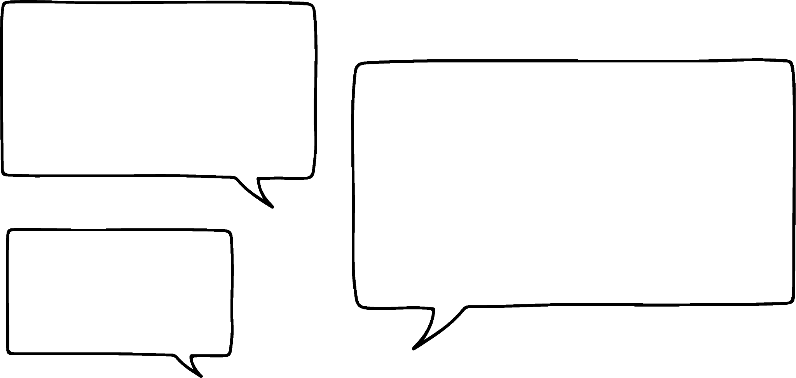

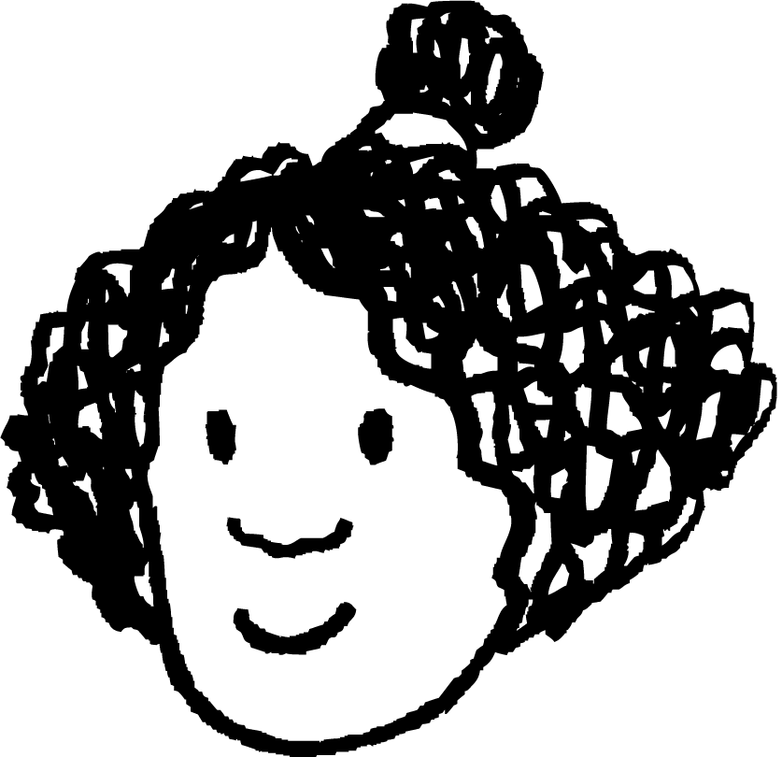

Xisaabinta xaglaha iyadoo la adeegsanayo qaacidada sine (sine formula)
xagal (angle) | sine (sine) | cosine (cosine) | tangent (tangent)
0 | 0 | 1 | 0
5 | 0.087 | 0.996 | 0.087
10 | 0.174 | 0.985 | 0.176
15 | 0.259 | 0.966 | 0.268
20 | 0.342 | 0.94 | 0.364
25 | 0.423 | 0.906 | 0.466
30 | 0.5 | 0.866 | 0.577
35 | 0.574 | 0.819 | 0.7
40 | 0.643 | 0.766 | 0.839
45 | 0.707 | 0.707 | 1
50 | 0.766 | 0.643 | 1.192
55 | 0.819 | 0.574 | 1.428
60 | 0.866 | 0.5 | 1.732
65 | 0.906 | 0.423 | 2.145
70 | 0.94 | 0.342 | 2.747
75 | 0.966 | 0.259 | 3.732
80 | 0.985 | 0.174 | 5.671
85 | 0.996 | 0.087 | 11.43
90 | 1 | 0 | ∞
Waxaan hubaa inaan isticmaali karo shaqada sine (sine function) si aan u helo dhererka hypotenuse ama opposite ee saddexagal qumman (right-angled triangle)…
Waan ogahay sida loo helo qiimaha (value) x ee saddexagalkaan, maxaa yeelay waa saddexagal ka mid ah goobada halbeegga (unit circle).
Isra
79 cm
hyp
79 × sin(42°) cm
52.86 cm
x cm
opp
42°

Slide 24
Xisaabinta xaglaha iyadoo la adeegsanayo qaacidada sine (sine formula)
xagal (angle) | sine (sine) | cosine (cosine) | tangent (tangent)
0 | 0 | 1 | 0
5 | 0.087 | 0.996 | 0.087
10 | 0.174 | 0.985 | 0.176
15 | 0.259 | 0.966 | 0.268
20 | 0.342 | 0.94 | 0.364
25 | 0.423 | 0.906 | 0.466
30 | 0.5 | 0.866 | 0.577
35 | 0.574 | 0.819 | 0.7
40 | 0.643 | 0.766 | 0.839
45 | 0.707 | 0.707 | 1
50 | 0.766 | 0.643 | 1.192
55 | 0.819 | 0.574 | 1.428
60 | 0.866 | 0.5 | 1.732
65 | 0.906 | 0.423 | 2.145
70 | 0.94 | 0.342 | 2.747
75 | 0.966 | 0.259 | 3.732
80 | 0.985 | 0.174 | 5.671
85 | 0.996 | 0.087 | 11.43
90 | 1 | 0 | ∞
…laakiin ma suurtagal tahay in la helo cabbirka xagal iyadoo la adeegsanayo qaacidada sine (sine formula)?
Isra
jibaabka (hyp)
10 cm
7.07 cm
dhinaca ka soo horjeeda (opp)
θ°

Slide 25
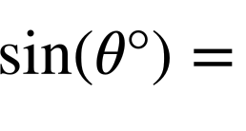
Xisaabinta xaglaha iyadoo la isticmaalayo qaacidada sine (sine formula)
xagal (angle) | sine (sine) | cosine (cosine) | tangent (tangent)
0 | 0 | 1 | 0
5 | 0.087 | 0.996 | 0.087
10 | 0.174 | 0.985 | 0.176
15 | 0.259 | 0.966 | 0.268
20 | 0.342 | 0.94 | 0.364
25 | 0.423 | 0.906 | 0.466
30 | 0.5 | 0.866 | 0.577
35 | 0.574 | 0.819 | 0.7
40 | 0.643 | 0.766 | 0.839
45 | 0.707 | 0.707 | 1
50 | 0.766 | 0.643 | 1.192
55 | 0.819 | 0.574 | 1.428
60 | 0.866 | 0.5 | 1.732
65 | 0.906 | 0.423 | 2.145
70 | 0.94 | 0.342 | 2.747
75 | 0.966 | 0.259 | 3.732
80 | 0.985 | 0.174 | 5.671
85 | 0.996 | 0.087 | 11.43
90 | 1 | 0 | ∞
Waxaan isticmaali karnaa nooca qaacidada sine (sine formula) halkaasoo sin(θ°) ay tahay mawduuca.
sine (sine)
Ku beddel dhererka jibaabka (hypotenuse) iyo dhinaca ka soo horjeeda θ°.
45
0.707
7.07
0.707
= 0.707
10
Si loo helo xagasha, waxaan ka raadinaa 0.707 tiirka sine (sine column) waxaanna hubinaa xagasha u dhigma.
jibaabka (hyp)
10 cm
7.07 cm
dhinaca ka soo horjeeda (opp)
45°
θ°

Slide 26
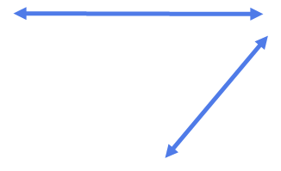
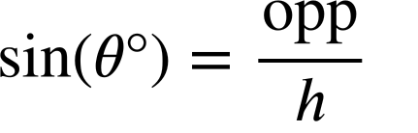
Xisaabinta xaglaha iyadoo la isticmaalayo qaacidada sine (sine formula)
xagal (angle) | sine (sine) | cosine (cosine) | tangent (tangent)
0 | 0 | 1 | 0
5 | 0.087 | 0.996 | 0.087
10 | 0.174 | 0.985 | 0.176
15 | 0.259 | 0.966 | 0.268
20 | 0.342 | 0.94 | 0.364
25 | 0.423 | 0.906 | 0.466
30 | 0.5 | 0.866 | 0.577
35 | 0.574 | 0.819 | 0.7
40 | 0.643 | 0.766 | 0.839
45 | 0.707 | 0.707 | 1
50 | 0.766 | 0.643 | 1.192
55 | 0.819 | 0.574 | 1.428
60 | 0.866 | 0.5 | 1.732
65 | 0.906 | 0.423 | 2.145
70 | 0.94 | 0.342 | 2.747
75 | 0.966 | 0.259 | 3.732
80 | 0.985 | 0.174 | 5.671
85 | 0.996 | 0.087 | 11.43
90 | 1 | 0 | ∞
Isra waxay heshay qiime (value) ee sin(θ°) ee saddexagalkan.
Adigoo isticmaalaya shaxda raadinta, hel cabbirka xagasha θ°.
sine (sine)
25 cm
θ°
23.5 cm
θ° = 70°
23.5
= 0.94
25
70
0.94

Slide 27
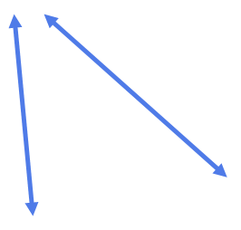
Xisaabinta xagasha iyadoo la isticmaalayo qaacidada sine
xagal (angle) | sine | cosine | tangent
0 | 0 | 1 | 0
5 | 0.087 | 0.996 | 0.087
10 | 0.174 | 0.985 | 0.176
15 | 0.259 | 0.966 | 0.268
20 | 0.342 | 0.94 | 0.364
25 | 0.423 | 0.906 | 0.466
30 | 0.5 | 0.866 | 0.577
35 | 0.574 | 0.819 | 0.7
40 | 0.643 | 0.766 | 0.839
45 | 0.707 | 0.707 | 1
50 | 0.766 | 0.643 | 1.192
55 | 0.819 | 0.574 | 1.428
60 | 0.866 | 0.5 | 1.732
65 | 0.906 | 0.423 | 2.145
70 | 0.94 | 0.342 | 2.747
75 | 0.966 | 0.259 | 3.732
80 | 0.985 | 0.174 | 5.671
85 | 0.996 | 0.087 | 11.43
90 | 1 | 0 | ∞
Adigoo ku beddelaya dhererka hypotenuse iyo dhinaca ka soo horjeeda θ° ee qaacidada sine, isticmaal shaxda raadinta si aad u hesho cabbirka xagasha θ°.
sine
200 cm
173.2 cm
θ°
θ° = 60°
60
0.866
173.2
= 0.866
200

Slide 28
Xisaabinta xagasha iyadoo la isticmaalayo qaacidada sine
xagal (angle) | sine | cosine | tangent
0 | 0 | 1 | 0
5 | 0.087 | 0.996 | 0.087
10 | 0.174 | 0.985 | 0.176
15 | 0.259 | 0.966 | 0.268
20 | 0.342 | 0.94 | 0.364
25 | 0.423 | 0.906 | 0.466
30 | 0.5 | 0.866 | 0.577
35 | 0.574 | 0.819 | 0.7
40 | 0.643 | 0.766 | 0.839
45 | 0.707 | 0.707 | 1
50 | 0.766 | 0.643 | 1.192
55 | 0.819 | 0.574 | 1.428
60 | 0.866 | 0.5 | 1.732
65 | 0.906 | 0.423 | 2.145
70 | 0.94 | 0.342 | 2.747
75 | 0.966 | 0.259 | 3.732
80 | 0.985 | 0.174 | 5.671
85 | 0.996 | 0.087 | 11.43
90 | 1 | 0 | ∞
sine (sine)
Oh maya!
Kawaran haddii aan helo qiime (value) sin(θ°) oo aan ku jirin shaxda?
20
25
0.342
0.423
7
Isra
= 0.35
20
Waxaan ku arki karaa shaxda in θ° u dhexeyso 20° iyo 25°, laakiin ma sii saxan karaa?
20 cm
7 cm
θ°

Slide 29
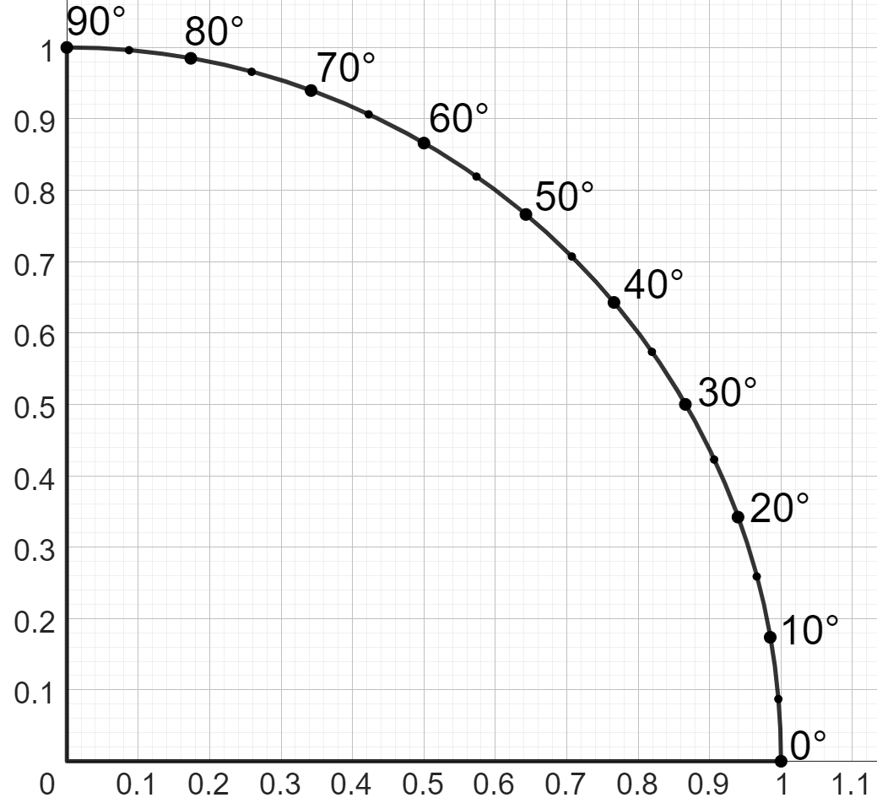
Xisaabinta xaglaha iyadoo la isticmaalayo qaacidada sine (sine formula)
Waxaad sidoo kale heli kartaa cabbirka xagasha θ° adigoo ka akhriya dhidibada goobta cutubka (unit circle), laga bilaabo dhidibka y (y-axis).
7
= 0.35
20
20 cm
7 cm
0.35 cutub (units)
θ°
21°
Xagasha θ° waxay qiyaas ahaan tahay 21°.

Slide 30
Xisaabinta xaglaha iyadoo la isticmaalayo qaacidada sine (sine formula)
Isticmaalka goobta cutubka (unit circle) ayaa ka fiican shaxda, laakiin waa mid aad u dheer, oo weli ma aha mid sax ah.
Isra
Ma jirtaa hab saxan oo lagu helo xagal?
Sida aan u isticmaali karno xisaabiyaha (calculator) si aan u helno dhererka dhinaca?

Slide 31
Xisaabinta xaglaha iyadoo la isticmaalayo qaacidada sine (sine formula)
Goobta cutubka (unit circle), waxaan ku heli karnaa dhererka dhinaca ka soo horjeeda xagasha 30° adigoo ku dabaqaya hawsha sine (sine function) xagashaas:
sin( 30° ) =
30°
0.5
xagal (angle)
dhererka dhinaca goobta cutubka (unit circle)
1 cutub (unit)
Hawsha sine (sine function) waxay leedahay hawl rogan (inverse function) oo loo yaqaan hawsha arcsine (arcsine function).
Waxaa laga yaabaa inaad ku aragto sin-1 xisaabiyaha (calculator).
30°

Slide 32
Xisaabinta xaglaha iyadoo la isticmaalayo qaacidada sine (sine formula)
Goobta (unit circle) dhexdeeda, waxaan ka heli karnaa dhererka dhinaca ka soo horjeeda xagasha 30° adigoo ku dabaqaya shaqada sine (sine function) xagashaas:
0.5
arcsine
arcsine
=
sin-1(0.5)
1 halbeeg (unit)
0.5
Jawaabaha:
dhererka dhinaca goobta (unit circle)
xagal (angle)
sin( 30° ) =
30°
30°
sin-1(30° ) =
30°
30°

Slide 33
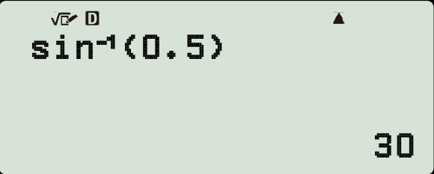

Xisaabinta xaglaha iyadoo la isticmaalayo qaacidada sine (sine formula)
Waxaan isticmaali karnaa shaqada arcsine ee xisaabiyaha (calculator) si aan u helno xagal.
sin-1( 30° ) =
30°
0.5
1 halbeeg (unit)
30°

Slide 34
Xisaabinta xaglaha iyadoo la isticmaalayo qaacidada sine (sine formula)
Kee ka mid ah isla'egyadan (equations) ayaa sax ah marka la raadinayo cabbirka xagasha n° ee isla'egta:
sin(n°) = 0.24?
a
c
b
d

Slide 35
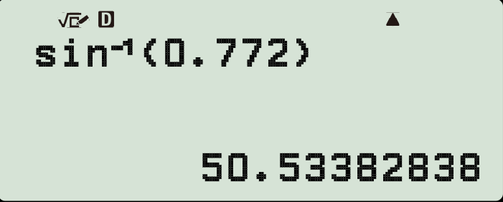
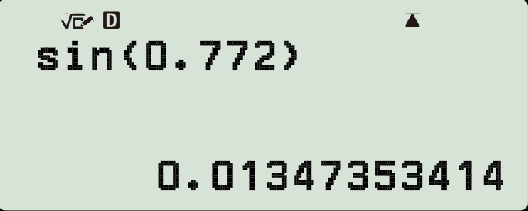


Xisaabinta xaglaha iyadoo la isticmaalayo qaacidada sine (sine formula)
Bandhigga xisaabiyaha (calculator display) kee ayaa sax ah marka la raadinayo cabbirka xagasha p° ee isla'egta:
sin(p°) = 0.772?
a
b
Helista cabbirka xagasha waxay u baahan doontaa isticmaalka arcsine, kaas oo lagu muujiyo sin-1 ee xisaabiyaha (calculator).

Slide 36
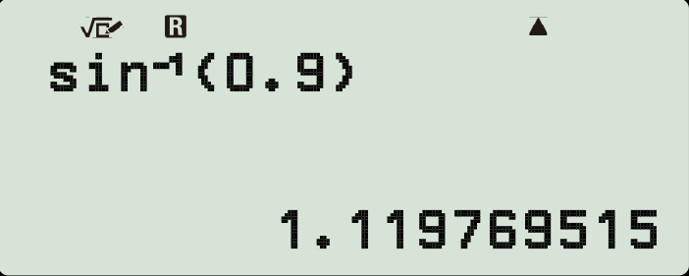
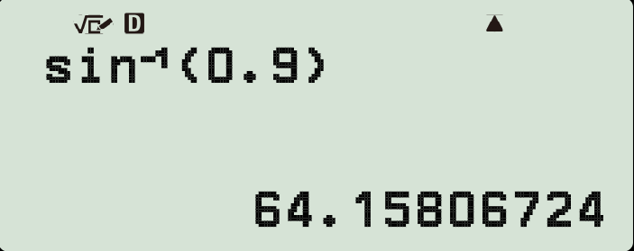

Xisaabinta xaglaha iyadoo la isticmaalayo qaacidada sine (sine formula)
Bandhigga kalkuleetarka (calculator display) kee baa sax ah marka la raadinayo cabbirka xagasha (angle) y° ee isla'egta (equation):
sin(y°) = 0.9?
a
b
Jawaabaha labadaba si sax ah ayaa loo geliyay kalkuleetarka (calculator).
Si kastaba ha ahaatee, kalkuleetarka (calculator) a wuxuu loo dejiyay raadiyaan (radians), ma aha darajo (degrees). Sidaa darteed, natiijadiisu ma aha xagal (angle) lagu bixiyay darajo (degrees).

Slide 37
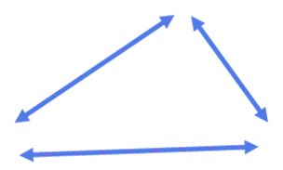
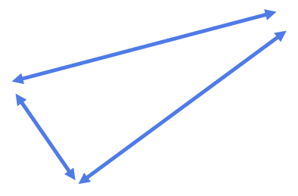
Xisaabinta xaglaha (angles) iyadoo la isticmaalayo qaacidada (formula) sine
xagal (angle) | sine | cosine | tangent
0 | 0 | 1 | 0
5 | 0.087 | 0.996 | 0.087
10 | 0.174 | 0.985 | 0.176
15 | 0.259 | 0.966 | 0.268
20 | 0.342 | 0.94 | 0.364
25 | 0.423 | 0.906 | 0.466
30 | 0.5 | 0.866 | 0.577
35 | 0.574 | 0.819 | 0.7
40 | 0.643 | 0.766 | 0.839
45 | 0.707 | 0.707 | 1
50 | 0.766 | 0.643 | 1.192
55 | 0.819 | 0.574 | 1.428
60 | 0.866 | 0.5 | 1.732
65 | 0.906 | 0.423 | 2.145
70 | 0.94 | 0.342 | 2.747
75 | 0.966 | 0.259 | 3.732
80 | 0.985 | 0.174 | 5.671
85 | 0.996 | 0.087 | 11.43
90 | 1 | 0 | ∞
1) Isticmaalka jaantuskan qiimaha (values) trig, hel cabbirka xagal kasta oo maqan oo lagu calaamadeeyay xaraf.
45.3 cm
25 cm
8.55 cm
b°
a°
50 cm
sin(a°) =
8.55
=
sin(b°) =
=
25
0.866 cm
200 cm
d°
1 cm
c°
17.4
cm

Slide 38
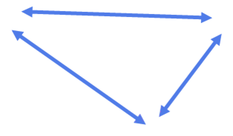
Xisaabinta xaglaha iyadoo la adeegsanayo qaacidada sine (sine formula)
2) Adoo sawiraya khadadka (lines) ku habboon qaybtan goobada (circle) halbeegga (unit), qiyaas cabbirka xagal kasta oo lagu calaamadeeyay xaraf (tiro dhan u dhow).
12 cm
sin(a°) =
12
=
0.8
15
a° =
15 cm
a°
25 cm
42 cm
b°
c°
11
cm
12.6 cm

Slide 39
Xisaabinta xaglaha iyadoo la adeegsanayo qaacidada sine (sine formula)
3) Isticmaal xisaabiyahaaga si aad u hesho cabbirka xagal kasta oo lagu calaamadeeyay xaraf (1 d.p.)
22 cm
24 cm
b°
9 cm
1 cm
a°
0.48 cm
18 cm
c°
sin(a°) =
9
sin(b°) =
24
a° = sin-1(
9
)
b° = sin-1(
)
=
=
24
3 cm
0.5 cm
0.5 cm
0.24 cm
0.48 cm
f°
d°
0.48 cm
e°

Slide 40
Xisaabinta xaglaha (angles) iyadoo la isticmaalayo qaacidada sine (sine formula)
xagal (angle) | sine (sine) | cosine (cosine) | tangent (tangent)
0 | 0 | 1 | 0
5 | 0.087 | 0.996 | 0.087
10 | 0.174 | 0.985 | 0.176
15 | 0.259 | 0.966 | 0.268
20 | 0.342 | 0.94 | 0.364
25 | 0.423 | 0.906 | 0.466
30 | 0.5 | 0.866 | 0.577
35 | 0.574 | 0.819 | 0.7
40 | 0.643 | 0.766 | 0.839
45 | 0.707 | 0.707 | 1
50 | 0.766 | 0.643 | 1.192
55 | 0.819 | 0.574 | 1.428
60 | 0.866 | 0.5 | 1.732
65 | 0.906 | 0.423 | 2.145
70 | 0.94 | 0.342 | 2.747
75 | 0.966 | 0.259 | 3.732
80 | 0.985 | 0.174 | 5.671
85 | 0.996 | 0.087 | 11.43
90 | 1 | 0 | ∞
1) Isticmaal jaantuskan qiimaha (value) trig, hel cabbirka xagal (angle) kasta oo maqan oo calaamad u leh xaraf.
45.3 cm
25 cm
8.55 cm
65°
20°
50 cm
8.55
45.3
sin(a°) =
0.342
sin(b°) =
0.906
=
=
25
50
0.866 cm
200 cm
5°
60°
1 cm
17.4
cm

Slide 41
Xisaabinta xaglaha (angles) iyadoo la isticmaalayo qaacidada sine (sine formula)
2)
Xagal kasta ± 2° ee waxa la bixiyay waa qiyaas macquul ah.
12 cm
sin(a°) =
12
=
0.8
15
a° ≈
53°
15 cm
a°
25 cm
42 cm
17°
26°
11
cm
12.6 cm

Slide 42
Xisaabinta xaglaha iyadoo la adeegsanayo qaacidada sine (sine formula)
3) Isticmaal xisaabiyahaaga si aad u hesho cabbirka xagal kasta oo calaamad u leh (1 d.p.)
22 cm
24 cm
b°
9 cm
1 cm
a°
0.48 cm
18 cm
c°
9
sin(b°) =
18
sin(a°) =
22
24
c° = 28.7°
a° = sin-1(
9
)
22.0°
b° = sin-1(
18
)
54.9°
=
=
24
22
e° = 73.7°
3 cm
0.5 cm
0.5 cm
0.24 cm
0.48 cm
f°
d°
0.48 cm
d° = 9.2°
f° = 28.7°
e°

Slide 43
Isticmaalka saamiga sine (sine ratio)
Xiriirka ka dhexeeya hypotenuse-ka saddexagalka qumman (right-angled triangle) iyo dhinaca ka soo horjeeda xagal θ° waxaa loo qori karaa qaaciddo (formula) siyaabo kala duwan:
Qaaciddadan sine (sine formula) waxaa loo isticmaali karaa in lagu helo dhererka hypotenuse-ka, dhererka dhinaca ka soo horjeeda xagal θ°, ama cabbirka xagasha θ° lafteeda.
Si loo helo cabbirka xagasha, waa in la isticmaalaa shaqada ka soo horjeeda shaqada sine (sine function): shaqada arcsine (arcsine function).
Kalkuleytarka, shaqada arcsine (arcsine function) waxaa badanaa loo qoraa sin-1.

