Slide 1
Isticmaalka saamiga taanjanta (tangent ratio)
Trigonometry

Slide 2
Sida agabkeena waxbarista loogu talagalay fasalka

Slide 3
Waxaan isticmaali karaa saamiga taanjanta (tangent ratio) si aan u helo dhinaca ama xagasha maqan ee saddexagalka qumman (right-angled triangle).

Slide 4
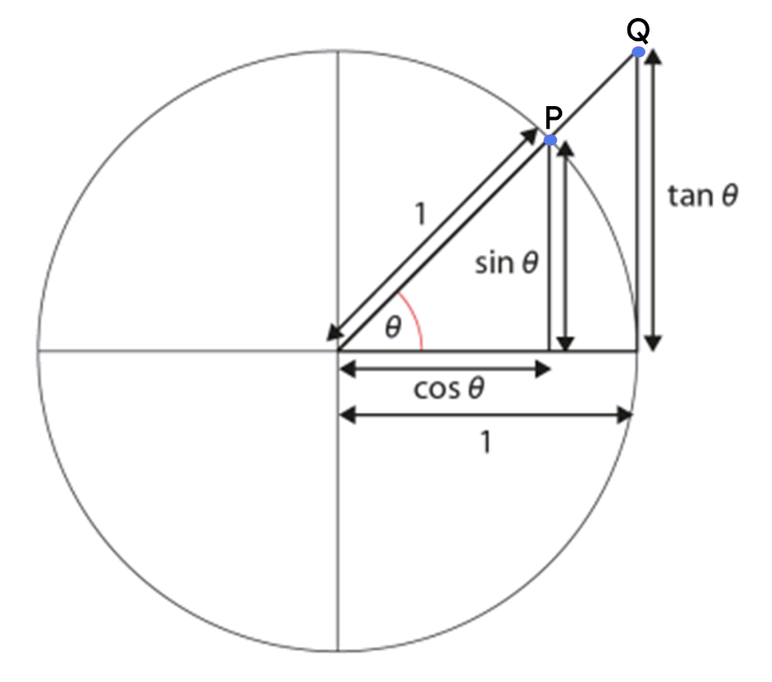
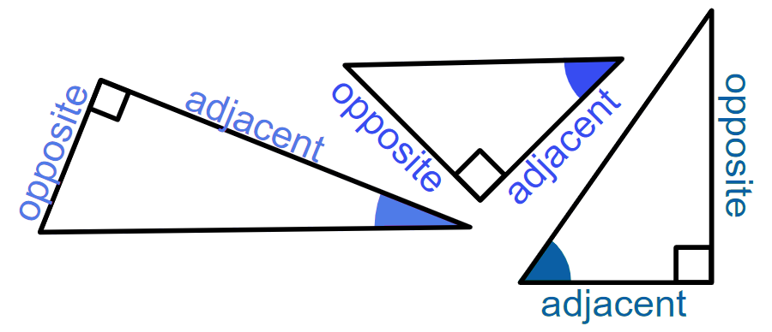
Hawlaha trigonometric waxaa sida caadiga ah lagu qeexaa saamiyada labada dhinac ee saddexagalka qumman (right-angled triangle) ee ka kooban xagasha.
Taanjanta xagal (tan(θ°)) waa isku-duwayaasha y (y-coordinate) ee barta Q ee saddexagalka ka soo baxa goobada halbeegga (unit circle).
Dhinaca ku xiga (adjacent side) ee saddexagalka qumman (right-angled triangle) waa dhinaca ku xiga xagasha qumman iyo xagasha calaamadsan labadaba.
Dhinaca ka soo horjeeda (opposite side) ee saddexagalka qumman (right-angled triangle) waa dhinaca ka soo horjeeda xagasha calaamadsan.

Slide 5

Isticmaalka saamiga taanjanta (tangent ratio)
Qaabaynta qaacidada taanjanta (tangent formula)
Xisaabinta xagasha

Slide 6
Qaabaynta qaacidada taanjanta (tangent formula)
Waxaan ognahay in labadan saddexagal ay isku mid yihiin (similar), sababtoo ah labada xagal ee hal saddexagal waxay la mid yihiin labada xagal ee kan kale.
Waxaan heli karnaa dhererka dhinaca lagu calaamadeeyay x adigoo isticmaalaya jaantus saami (ratio table).
× 0.67
1
0.67
× 12
× 12
12
0.67 × 12
8.04
8.04 cm
× 0.67
x cm
0.67 cm
42°
42°
× 12
12 cm
1 cm

Slide 7
Qaabaynta qaacidada tangent (Formalising the tangent formula)
Waxaan sidoo kale u soo koobi karnaa habkan saddexagal kasta oo qumman oo leh xagal θ°, halkaas oo dhinaca ka soo horjeeda θ° uu leeyahay dherer tan(θ°).
× tan(θ°)
1
tan(θ°)
× a
× a
a
a × tan(θ°)
opp
× tan(θ°)
a × tan(θ°)
dhinaca ka soo horjeeda (opp)
tan(θ°)
θ°
θ°
× a
1 cm
a cm

Slide 8
Qaabaynta qaacidada tangent (Formalising the tangent formula)
Waxaan sidoo kale u soo koobi karnaa habkan saddexagal kasta oo qumman oo leh xagal θ°, halkaas oo dhinaca ka soo horjeeda θ° uu leeyahay dherer tan(θ°).
1
tan(θ°)
a
dhinaca ka soo horjeeda (opp)
dhinaca ka soo horjeeda (opp)
a × tan(θ°)
a × tan(θ°)
× tan(θ°)
θ°
a cm
Dhererka dhinaca ku xiga (adjacent)
oo lagu dhuftay tangent-ka xagal θ°
wuxuu la mid yahay dhererka dhinaca ka soo horjeeda xagashaas.

Slide 9
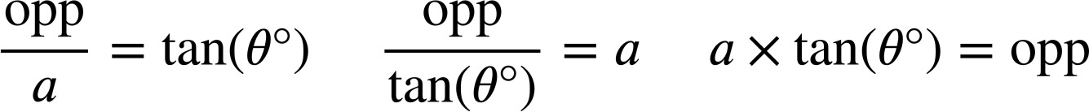
Qaabaynta qaacidada tangent (Formalising the tangent formula)
Waxaan u isticmaali karnaa jaantuskan saamiga (ratio table) si aan u soo saarno qaacidada (formula) oo muujinaysa xiriirka ka dhexeeya dhinaca ka soo horjeeda xagasha θ° iyo dhinaca ku xiga (adjacent), waxaana u matali karnaa qaacidada saddex siyaabood.
× tan(θ°)
Qaacidada tangent (The tangent formula)
1
tan(θ°)
tan(θ°)
× a
× a
÷ a
a
opp
a
opp
× tan(θ°)
÷ tan(θ°)
× tan(θ°)
a × tan(θ°)
lidka (opposite)
θ°
a cm

Slide 10
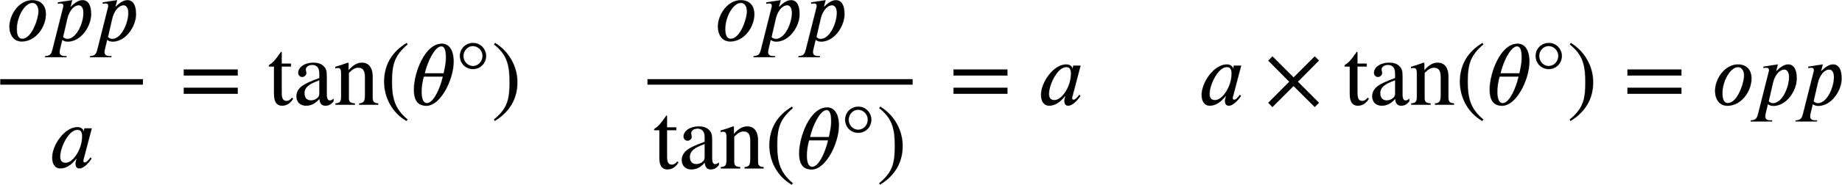
Qaabaynta qaacidada tangent (Formalising the tangent formula)
Waxaan kaloo ka soo qaadan karnaa laba nooc oo ka mid ah qaacidada marka la eego mid ka mid ah kuwa kale iyadoo la sameeyo qaybin (division).

Slide 11
Qaabaynta qaacidada tangent (Formalising the tangent formula)
Waxaan ku beddeli karnaa qiimayaasha (values) saddexagal qumman (right-angled triangle) nooc kasta oo ka mid ah qaacidada tangent si aan u matallo xiriirka ka dhexeeya dhinaca ka soo horjeeda xagasha iyo dhinaca ku xiga siyaabo kala duwan.
b × tan(67°) = 16
16
16 cm
= b
tan(67°)
67°
16
b cm
= tan(67°)
b

Slide 12



Qaabaynta qaacidada taanjanta (tangent formula)
Hal isle'eg oo sax ah oo muujinaysa xiriirka ka dhexeeya dhinaca ku xiga (adjacent) iyo dhinaca ka soo horjeeda (opposite) xagasha 38° waa:
1
tan(θ°)
× 20
× 20
20
opp
× tan(38°)
Kee ka mid ah kuwani sidoo kale wuxuu si sax ah u muujinayaa xiriirka ka dhexeeya dhinaca ku xiga (adjacent) iyo dhinaca ka soo horjeeda (opposite) ee saddex-xagalkan?
a
opp
38°
b
20 cm

Slide 13
Qaabaynta qaacidada taanjanta (tangent formula)
Kee ka mid ah kuwani wuxuu si sax ah u muujinayaa xiriirka ka dhexeeya dhinaca ku xiga (adjacent) iyo dhinaca ka soo horjeeda (opposite) xagasha 82° ee saddex-xagalkan (oo lagu soo koobay tirada ugu dhow)?
a
d
70 cm
b
e
82°
c
10 cm

Slide 14
Qaabaynta qaacidada taanjanta (tangent formula)
Nooc kasta oo ka mid ah qaacidada, qayb ka duwan oo saddex-xagalka ah ayaa loo qoray mawduuc (subject).
Waxaa faa'iido leh in la isticmaalo nooca qaacidada uu mawduuciisu (subject) u dhigma qaybta saddex-xagalka ee aad isku dayeyso inaad qiimeheeda (value) hesho.
55°
85 × tan(55°) = p
p cm
85 cm
p = 121.39 (2 d.p.)
opp
adj
Waxaan dooneynaa inaan helno qiimaha (value) p, oo ah dhererka dhinaca ka soo horjeeda (opposite) xagasha 55°.

Slide 15
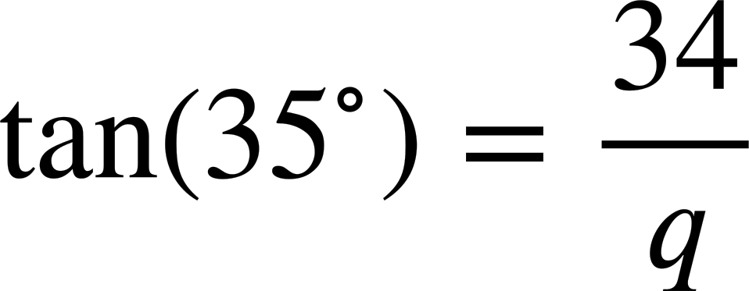
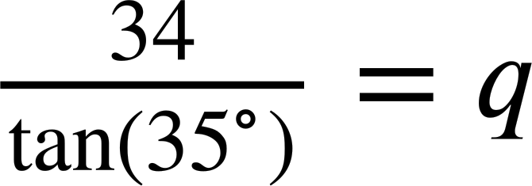
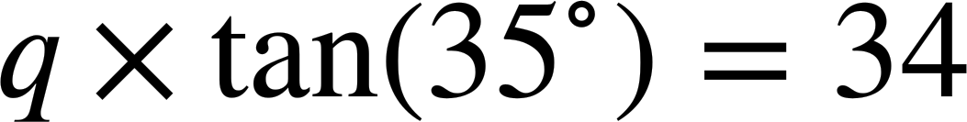
Qaabaynta qaacidada tangent (tangent formula)
Kee ka mid ah isle'egyadan ayaa ugu waxtar badan helista qiimaha (value) q?
Sidaa awgeed, hel dhererka dhinaca lagu calaamadeeyay q (2 d.p.)
a
48.56 m
q m
34 m
b
q = 48.56
35°
c

Slide 16
Qaabaynta qaacidada tangent (tangent formula)
1) Ku beddel dhinacyada iyo xagasha calaamadeysan ee saddexagal kasta labadan nooc ee qaacidada tangent (tangent formula).
Saddexagal kasta, dooro nooca ugu habboon ee qaacidada tangent (tangent formula) si aad u hesho dhererka dhinaca maqan.
× tan( ) =
× tan( ) =
49°
119 cm
2 cm
b cm
=
=
tan( )
tan( )
81°
a cm

Slide 17
Qaabaynta qaacidada taanjanta (tangent)
2) Isku dhig saddexagalka iyo isla'egta muujinaysa xiriirka ka dhexeeya dhinaca ku xiga (adjacent) iyo dhinaca ka soo horjeeda (opposite).
Isticmaal isla'egta si aad u hesho dhererka dhinaca maqan ee calaamadeysan x ee saddexagal kasta (2 d.p.)
a)
b)
c)
50°
32°
32 cm
x cm
x cm
32°
50 cm
x cm
50 cm
x × tan(32°) = 50
d
50 × tan(32°) = x
e
32 × tan(50°) = x
f

Slide 18
Qaabaynta qaacidada taanjanta (tangent)
3) Adigoo isticmaalaya qaacidada taanjanta (tangent), hel dhererka dhinaca maqan ee calaamadeysan xaraf ujeedo saddexagal kasta (2 d.p.)
a)
b)
c)
a cm
b cm
c cm
39°
39°
49°
1 cm
14.9 cm
14.9 cm
d)
e)
f)
41°
e cm
14.9 cm
49 cm
49°
14.9°
d cm
14.9 cm
f cm

Slide 19
Qaabaynta qaacidada tangent (Formalising the tangent formula)
4) Hel dhererka masaafada a, b, c, iyo d (ku soo koob tirada ugu dhow).
64 cm
c cm
39.5 cm
a cm
27°
50 cm
b cm
10 cm
d cm

Slide 20
Qaabaynta qaacidada tangent (Formalising the tangent formula)
1) Ku beddel dhinacyada iyo xagasha la calaamadeeyay saddexagal kasta labadan nooc ee qaacidada tangent.
Saddexagal kasta, dooro nooca ugu habboon ee qaacidada tangent si aad u hesho dhererka dhinaca maqan.
× tan( ) =
× tan( ) =
a
81°
119
2
49°
b
49°
119
119 cm
b
2 cm
b cm
a
2
=
=
tan( )
tan( )
81°
49°
81°
a cm = 18.85 cm
b cm = 2.30 cm
a cm

Slide 21
Qaabaynta qaacidada taanjanta (tangent formula)
2) Isku dhig saddexagalka iyo isla'egta tusaysa xiriirka ka dhexeeya dhinaca ku xiga (adjacent) iyo dhinaca ka soo horjeeda (opposite).
Isticmaal isla'egta si aad u hesho dhererka dhinaca maqan ee lagu calaamadeeyay x ee saddexagal kasta (2 d.p.)
a)
b)
c)
50°
32°
32 cm
x cm
x cm
32°
50 cm
x cm
50 cm
50 × tan(32°) = x
e
32 × tan(50°) = x
f
x × tan(32°) = 50
d
x = 31.24
x = 38.14
x = 80.02
Dhinaca ka soo horjeeda 32° wuxuu leeyahay dherer dhan 31.24 cm
Dhinaca ka soo horjeeda 50° wuxuu leeyahay dherer dhan 38.14 cm
Dhinaca ku xiga (adjacent) wuxuu leeyahay dherer dhan 80.02 cm

Slide 22
Qaabaynta qaacidada tangent (Formalising the tangent formula)
3) Adigoo isticmaalaya qaacidada taanjanta (tangent formula), soo hel dhererka dhinaca maqan ee lagu calaamadeeyay xaraf ee saddexagal kasta (2 d.p.)
a)
b)
c)
a cm
b cm
c cm
39°
39°
49°
1 cm
a = 0.81
14.9 cm
b = 12.07
14.9 cm
c = 17.14
d)
e)
f)
41°
e cm
14.9 cm
49 cm
49°
49°
14.9°
d cm
14.9 cm
f cm
d = 12.95
e = 17.14
f = 184.16

Slide 23
Qaabaynta qaacidada tangent (Formalising the tangent formula)
4) Raadi dhererka masaafada a, b, c, iyo d (ku soo wareeji tirada ugu dhow).
45 cm
64 cm
c cm
25 cm
39.5 cm
a cm
27°
50 cm
b cm
10 cm
d cm
28 cm
38 cm

Slide 24
Isticmaalka saamiga tangent (Using the tangent ratio)
Qaabaynta qaacidada tangent (Formalising the tangent formula)
Xisaabinta xagasha (Calculating the angle)

Slide 25
Xisaabinta xagasha (Calculating the angle)
xagal (angle) | sine (sine) | cosine (cosine) | tangent (tangent)
0 | 0 | 1 | 0
5 | 0.087 | 0.996 | 0.087
10 | 0.174 | 0.985 | 0.176
15 | 0.259 | 0.966 | 0.268
20 | 0.342 | 0.94 | 0.364
25 | 0.423 | 0.906 | 0.466
30 | 0.5 | 0.866 | 0.577
35 | 0.574 | 0.819 | 0.7
40 | 0.643 | 0.766 | 0.839
45 | 0.707 | 0.707 | 1
50 | 0.766 | 0.643 | 1.192
55 | 0.819 | 0.574 | 1.428
60 | 0.866 | 0.5 | 1.732
65 | 0.906 | 0.423 | 2.145
70 | 0.94 | 0.342 | 2.747
75 | 0.966 | 0.259 | 3.732
80 | 0.985 | 0.174 | 5.671
85 | 0.996 | 0.087 | 11.43
90 | 1 | 0 | ∞
opp
tan (𝜃°) =
0.7 units
adj
𝜃°
0.7
tan (𝜃°) =
1
1 unit
Waa immisa xagasha 𝜃° marka saamiga u dhexeeya ka soo horjeeda iyo kuwa ku xiga uu yahay 0.7 : 1?
𝜃° = 35°

Slide 26
Xisaabinta xagasha (angle)
xagal (angle) | sine (sine) | cosine (cosine) | tangent (tangent)
0 | 0 | 1 | 0
5 | 0.087 | 0.996 | 0.087
10 | 0.174 | 0.985 | 0.176
15 | 0.259 | 0.966 | 0.268
20 | 0.342 | 0.94 | 0.364
25 | 0.423 | 0.906 | 0.466
30 | 0.5 | 0.866 | 0.577
35 | 0.574 | 0.819 | 0.7
40 | 0.643 | 0.766 | 0.839
45 | 0.707 | 0.707 | 1
50 | 0.766 | 0.643 | 1.192
55 | 0.819 | 0.574 | 1.428
60 | 0.866 | 0.5 | 1.732
65 | 0.906 | 0.423 | 2.145
70 | 0.94 | 0.342 | 2.747
75 | 0.966 | 0.259 | 3.732
80 | 0.985 | 0.174 | 5.671
85 | 0.996 | 0.087 | 11.43
90 | 1 | 0 | ∞
opp
tan (𝜃°) =
2.184 units
adj
𝜃°
2.184
tan (𝜃°) =
6
6 units
tan (𝜃°) = 0.364
Xagal (angle) kee baa qiime (value) 0.364 u siin doona tan (𝜃°)?
𝜃° = 20°

Slide 27
Xisaabinta xaglaha (angle)
xagal (angle) | sine | cosine | tangent
0 | 0 | 1 | 0
5 | 0.087 | 0.996 | 0.087
10 | 0.174 | 0.985 | 0.176
15 | 0.259 | 0.966 | 0.268
20 | 0.342 | 0.94 | 0.364
25 | 0.423 | 0.906 | 0.466
30 | 0.5 | 0.866 | 0.577
35 | 0.574 | 0.819 | 0.7
40 | 0.643 | 0.766 | 0.839
45 | 0.707 | 0.707 | 1
50 | 0.766 | 0.643 | 1.192
55 | 0.819 | 0.574 | 1.428
60 | 0.866 | 0.5 | 1.732
65 | 0.906 | 0.423 | 2.145
70 | 0.94 | 0.342 | 2.747
75 | 0.966 | 0.259 | 3.732
80 | 0.985 | 0.174 | 5.671
85 | 0.996 | 0.087 | 11.43
90 | 1 | 0 | ∞
opp
tan (𝜃°) =
2.563 units
adj
𝜃°
2.563
tan (𝜃°) =
5.5
5.5 units
tan (𝜃°) = 0.466
Xaglaha (angle) kee baa siin doona qiime (value) 0.466 ee tan (𝜃°)?
𝜃° = 25°
25°

Slide 28
Xisaabinta xaglaha (angle)
xagal (angle) | sine | cosine | tangent
0 | 0 | 1 | 0
5 | 0.087 | 0.996 | 0.087
10 | 0.174 | 0.985 | 0.176
15 | 0.259 | 0.966 | 0.268
20 | 0.342 | 0.94 | 0.364
25 | 0.423 | 0.906 | 0.466
30 | 0.5 | 0.866 | 0.577
35 | 0.574 | 0.819 | 0.7
40 | 0.643 | 0.766 | 0.839
45 | 0.707 | 0.707 | 1
50 | 0.766 | 0.643 | 1.192
55 | 0.819 | 0.574 | 1.428
60 | 0.866 | 0.5 | 1.732
65 | 0.906 | 0.423 | 2.145
70 | 0.94 | 0.342 | 2.747
75 | 0.966 | 0.259 | 3.732
80 | 0.985 | 0.174 | 5.671
85 | 0.996 | 0.087 | 11.43
90 | 1 | 0 | ∞
soohor (opp)
tan (𝜃°) =
ku xiga (adj)
22.392units
tan (𝜃°) =
22.392
6
𝜃°
tan (𝜃°) = 3.732
6 units
Xaggee ayaa bixin doonta qiime (value) 3.732 oo ah tan(𝜃°)?
𝜃° = 75°

Slide 29
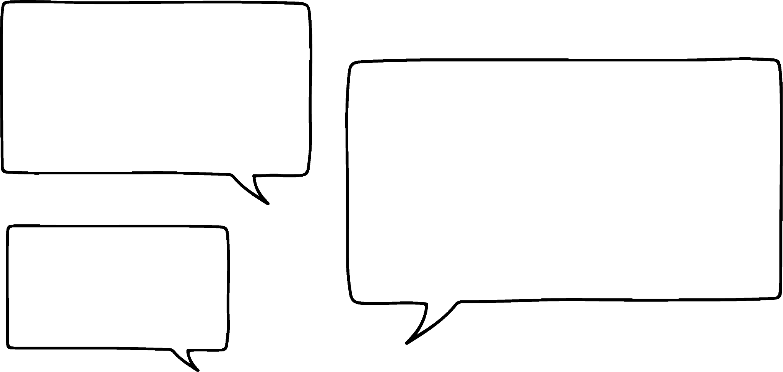

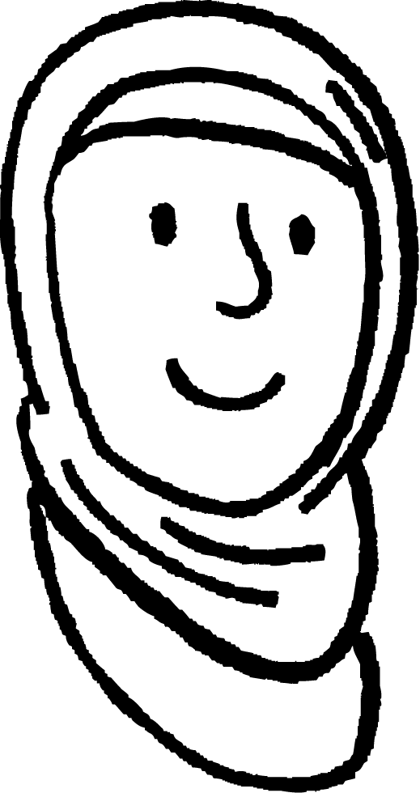

Xisaabinta xagasha (angle)
xagal (angle) | sine (sine) | cosine (cosine) | tangent (tangent)
0 | 0 | 1 | 0
5 | 0.087 | 0.996 | 0.087
10 | 0.174 | 0.985 | 0.176
15 | 0.259 | 0.966 | 0.268
20 | 0.342 | 0.94 | 0.364
25 | 0.423 | 0.906 | 0.466
30 | 0.5 | 0.866 | 0.577
35 | 0.574 | 0.819 | 0.7
40 | 0.643 | 0.766 | 0.839
45 | 0.707 | 0.707 | 1
50 | 0.766 | 0.643 | 1.192
55 | 0.819 | 0.574 | 1.428
60 | 0.866 | 0.5 | 1.732
65 | 0.906 | 0.423 | 2.145
70 | 0.94 | 0.342 | 2.747
75 | 0.966 | 0.259 | 3.732
80 | 0.985 | 0.174 | 5.671
85 | 0.996 | 0.087 | 11.43
90 | 1 | 0 | ∞
Sideen u helaynaa xaglo (angles) aan ku jirin shaxdaas?
22.392 cagood (units)
𝜃°
6 cagood (units)
Caasha
Xaggee ayaa bixin doonta qiime (value) 3.732 oo ah tan(𝜃°)?
𝜃° = 75°
Waxaan isticmaali karnaa goobta (unit circle) si aan u helno xaglo (angles) dheeri ah.

Slide 30
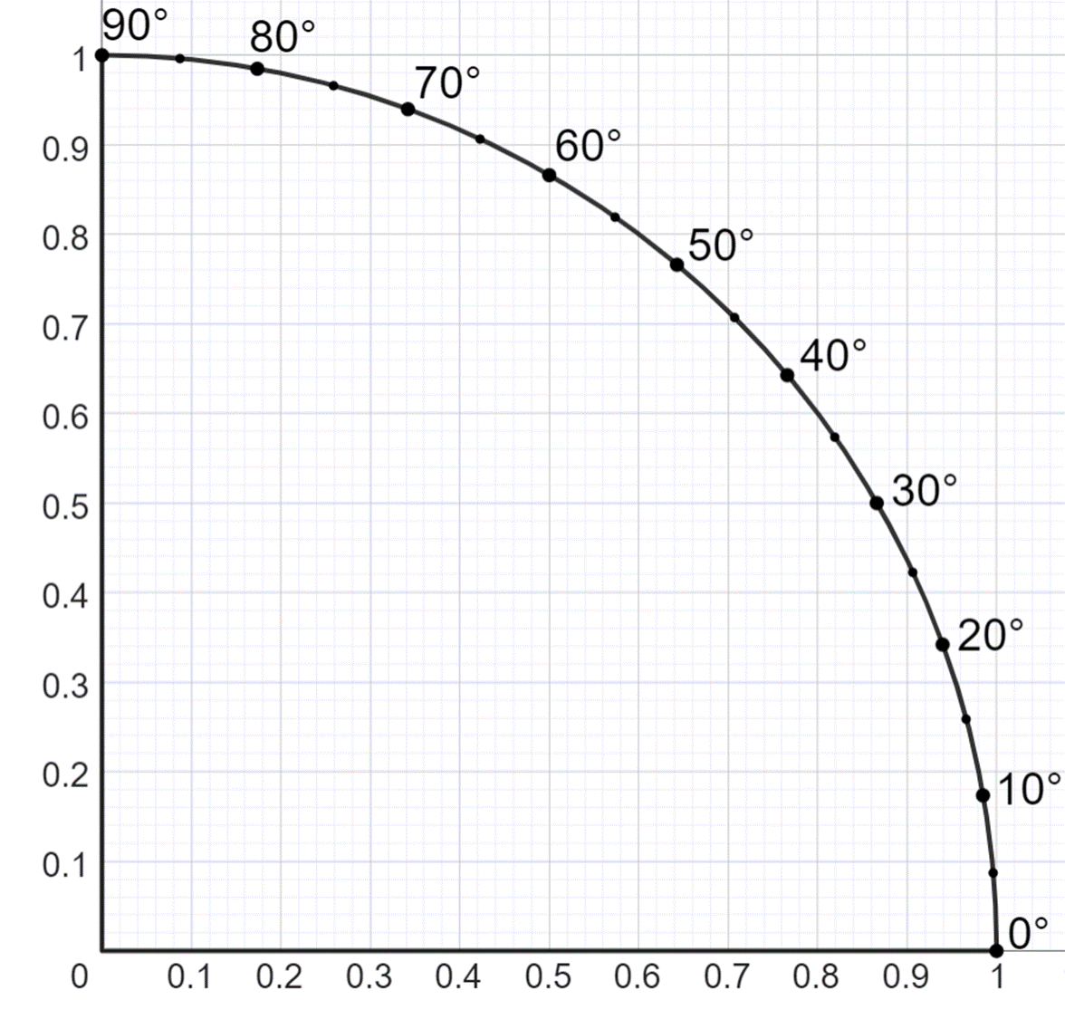
Xisaabinta xagasha (angle)
xagal (angle) | sine (sine) | cosine (cosine) | tangent (tangent)
0 | 0 | 1 | 0
5 | 0.087 | 0.996 | 0.087
10 | 0.174 | 0.985 | 0.176
15 | 0.259 | 0.966 | 0.268
20 | 0.342 | 0.94 | 0.364
25 | 0.423 | 0.906 | 0.466
30 | 0.5 | 0.866 | 0.577
35 | 0.574 | 0.819 | 0.7
40 | 0.643 | 0.766 | 0.839
45 | 0.707 | 0.707 | 1
50 | 0.766 | 0.643 | 1.192
55 | 0.819 | 0.574 | 1.428
60 | 0.866 | 0.5 | 1.732
65 | 0.906 | 0.423 | 2.145
70 | 0.94 | 0.342 | 2.747
75 | 0.966 | 0.259 | 3.732
80 | 0.985 | 0.174 | 5.671
85 | 0.996 | 0.087 | 11.43
90 | 1 | 0 | ∞
30°

Slide 31
Xisaabinta xagasha (angle)
0.5 halbeeg (unit)
𝜃°
1.2 halbeeg (unit)
opp
qiyaastii 22.5°
tan (𝜃°) =
adj
0.5
tan (𝜃°) =
1.2
tan (𝜃°) = 0.417
𝜃°

Slide 32
Xisaabinta xagasha (angle)
1 halbeeg (unit)
𝜃°
1.4 halbeeg (unit)
opp
qiyaastii 35.5°
tan (𝜃°) =
adj
1
tan (𝜃°) =
1.4
𝜃°
tan (𝜃°) = 0.714

Slide 33
Xisaabinta xagasha (angle)
1.5 unit
𝜃°
1.8 unit
opp
qiyaastii
tan (𝜃°) =
39.8
adj
°
1.5
tan (𝜃°) =
1.8
𝜃°
tan (𝜃°) = 0.833

Slide 34
Xisaabinta xagasha (Calculating the angle)
Haa, laakiin habkani ma aha mid sax ah.
Waa inay jirtaa hab kale, oo aan ku tiirsanayn shax (table) ama garaaf (graph) oo ka sax badan.
Caasha

Slide 35
Xisaabinta xagasha (Calculating the angle)
ka soo horjeeda (opposite)
Shaqada taanjanta (tangent function), tan (𝜃°), waxay soo celisaa saamiga (ratio) ee qiime (value) la siiyay 𝜃°.
ku xiga (adjacent)
Haddii aad ka heli karto saamiga (ratio) xagasha, waxaa suurtogal ah inaad isticmaasho rogaal-celinta (inverse) si aad uga hesho xagasha saamiga (ratio) la siiyay. Xisaabiyahaagu (calculator) wuxuu kaa caawinayaa inaad tan si degdeg ah oo sax ah u samayso.

Slide 36

Xisaabinta xagasha (Calculating the angle)
Haddii shaqada taanjanta (tangent function) ay tahay sida hawlgalka (operation) lagu helo saamiga (ratio) xagasha, markaas rogaal-celinta shaqada taanjanta (inverse of the tangent function) waxay ka heshaa xagasha saamiga (ratio).
shaqada rogaal-celinta taanjanta (inverse tangent function)
tan (𝜃°) = 0.714
shaqada rogaal-celinta taanjanta (inverse tangent function)
𝜃° = shaqada rogaal-celinta taanjanta (inverse tangent function) (0.714)
Ku qoran xisaabiyahaaga sayniska (scientific calculator)
Shaqada tangent-ka rogaal celiska ah waxaa loo yaqaan arctangent (arctangent).
Jawaabaha:
𝜃° = tan-1 (0.714)
= arctan(0.714)
𝜃° = 35.52683659°
𝜃° = 35.5° (1 dp)

Slide 37
Xisaabinta xagasha (angle)
Kee ka mid ah kuwan soo socdaa waxay u dhigmaan 𝜃° = tan-1 (0.382) ?
𝜃° = 20.9°
𝜃° = arctan(0.382)
tan(𝜃°) = 0.382
𝜃° = tan(0.382)

Slide 38
Xisaabinta xagasha (angle)
xagal (angle) | sine (sine) | cosine (cosine) | tangent (tangent)
0 | 0 | 1 | 0
5 | 0.087 | 0.996 | 0.087
10 | 0.174 | 0.985 | 0.176
15 | 0.259 | 0.966 | 0.268
20 | 0.342 | 0.94 | 0.364
25 | 0.423 | 0.906 | 0.466
30 | 0.5 | 0.866 | 0.577
35 | 0.574 | 0.819 | 0.7
40 | 0.643 | 0.766 | 0.839
45 | 0.707 | 0.707 | 1
50 | 0.766 | 0.643 | 1.192
55 | 0.819 | 0.574 | 1.428
60 | 0.866 | 0.5 | 1.732
65 | 0.906 | 0.423 | 2.145
70 | 0.94 | 0.342 | 2.747
75 | 0.966 | 0.259 | 3.732
80 | 0.985 | 0.174 | 5.671
85 | 0.996 | 0.087 | 11.43
90 | 1 | 0 | ∞
1) Isticmaal jaantuska qiimaha (value) si aad u ogaato xagasha (angle) maqan ee saddexagal kasta.
a)
b)
8.39 cm
21.65 cm
𝜃°
10 cm
𝜃°
12.5 cm
c)
d)
𝜃°
5 mm
20 m
7.28 m
𝜃°
5 mm

Slide 39
Xisaabinta xagasha (angle)
2) Adoo sawiraya khadadka ku habboon ee garaafka, qiyaas xagasha (angle) ee saddexagal kasta.
a)
8 cm
𝜃°
10 cm
b)
𝜃°
80 mm
81.6 mm

Slide 40
Xisaabinta xagasha (Calculating the angle)
3) Isticmaal xisaabiyahaaga (calculator) si aad u ogaato xagasha (angle) ka maqan saddexagal kasta, adigoo ku jawaabaya 1 meel jajab tobanle (1 decimal place).
a)
b)
𝜃°
8 cm
3.2 m
𝜃°
8.9 m
10 cm
c)
d)
121 cm
𝜃°
59 cm
80 mm
𝜃°
81.6 mm

Slide 41
Xisaabinta xagasha (Calculating the angle)
xagal (angle) | sine (sine) | cosine (cosine) | tangent (tangent)
0 | 0 | 1 | 0
5 | 0.087 | 0.996 | 0.087
10 | 0.174 | 0.985 | 0.176
15 | 0.259 | 0.966 | 0.268
20 | 0.342 | 0.94 | 0.364
25 | 0.423 | 0.906 | 0.466
30 | 0.5 | 0.866 | 0.577
35 | 0.574 | 0.819 | 0.7
40 | 0.643 | 0.766 | 0.839
45 | 0.707 | 0.707 | 1
50 | 0.766 | 0.643 | 1.192
55 | 0.819 | 0.574 | 1.428
60 | 0.866 | 0.5 | 1.732
65 | 0.906 | 0.423 | 2.145
70 | 0.94 | 0.342 | 2.747
75 | 0.966 | 0.259 | 3.732
80 | 0.985 | 0.174 | 5.671
85 | 0.996 | 0.087 | 11.43
90 | 1 | 0 | ∞
1) Isticmaal shaxda qiimaha (table of values) si aad u ogaato xagasha (angle) ka maqan saddexagal kasta.
a)
b)
8.39 cm
21.65 cm
40°
10 cm
60°
12.5 cm
c)
d)
45°
5 mm
20 m
7.28 m
20°
5 mm

Slide 42
Xisaabinta xagasha (angle)
2) Adigoo ku sawiraya xariiqo ku habboon garaafka, qiyaas xagasha (angle) saddexagal kasta.
a)
8 cm
38.7°
b)
10 cm
Jawaabaha qiyaasta ah waa la aqbali karaa.
a)
b)
45.6°
80 mm
81.6 mm

Slide 43
Xisaabinta xagasha (angle)
3) Isticmaal xisaabiyahaaga (calculator) si aad u ogaato xagasha (angle) maqan saddexagal kasta, adigoo ku siinaya jawaabtaada hal meel jajab tobanle (1 decimal place).
a)
b)
8 cm
3.2 m
70.2°
38.7°
8.9 m
10 cm
c)
d)
121 cm
45.6°
59 cm
80 mm
26.0°
81.6 mm

Slide 44
Isticmaalka saamiga taanjanta (tangent ratio)
Saamiga taanjanta (tangent ratio) wuxuu ku lug leeyahay dhinaca ka soo horjeeda (opposite), dhinaca ku xiga (adjacent), iyo xagasha (angle).
Xiriirka ka dhexeeya kuwan waxaa lagu muujin karaa saddex siyaabood oo kala duwan:
Qaacidada taanjanta (tangent formula) waxaa loo isticmaali karaa in lagu helo dhererka dhinaca ka soo horjeeda (opposite), dhererka dhinaca ku xiga xagasha θ°, ama cabbirka xagasha θ° lafteeda.
Si loo helo cabbirka xagasha, waa in la isticmaalaa shaqada ka soo horjeeda shaqada taanjanta (tangent function): shaqada arctanjanta (arctangent function).
Xisaabiyaha (calculator), shaqada arctanjanta (arctangent function) badanaa waxaa loo qoraa tan-1.

