Slide 1
Isticmaalida jaantusyada laba-geesoodka ah (two-way tables) si loo muujiyo natiijooyinka laba dhacdo (events)
Itimaalka (Probability): natiijooyinka suurtagalka ah (possible outcomes)

Slide 2
Sida agabkeena waxbarista loogu talagalay fasalka

Slide 3
Waxaan si nidaamsan u heli karaa dhammaan natiijooyinka suurtagalka ah (possible outcomes) ee laba dhacdo (events) adigoo isticmaalaya jaantus laba-geesood ah (two-way table).

Slide 4
Jaantuska natiijada (outcome table) waa jaantus muujinaya dhammaan natiijooyinka suurtagalka ah (possible outcomes).

Slide 5

Isticmaalida jaantusyada laba-geesoodka ah (two-way tables) si loo muujiyo natiijooyinka laba dhacdo (events)
Jaantuska natiijada (outcome table) ee tijaabo laba-wareeg ah (two-stage trial)
Jaantuska natiijada (outcome table) ee laba dhacdo (events)
Soo noqnoqoshada (Frequency) ee jaantuska laba-geesoodka ah (two-way table)

Slide 6
Jaantuska natiijada (outcome table) ee tijaabo laba-wareeg ah (two-stage trial)
Haddii aan si laba jeer u wareejinno wareejintaan (spinner), waa maxay natiijooyinka suurtagalka ah (possible outcomes)?
Waxaan samayn karnaa jaantus natiijada (outcome table) si aan u go'aamino natiijooyinka suurtagalka ah (possible outcomes).
wareejin 1 (spin 1)
guul (win)
guuldarro (lose)
Tiirarka (columns) waxay noqon doonaan natiijooyinka wareejinta 1 (spin 1).
guul (win)
guuldarro (lose)
guul, guul
khasaare, guul
Safka (rows) waxay noqon doonaan natiijooyinka wareejinta 2 (spin 2).
guul (win)
wareejin 2 (spin 2)
guul, khasaare
khasaare, khasaare
guuldarro (lose)

Slide 7
Shaxda natiijooyinka tijaabada laba-tallaabo (Natiijada table from a two-stage trial)
Haddii aan laba jeer wareejinno wareejiyahan (spinner), maxay yihiin natiijooyinka suurtogalka ah?
Shaxda natiijooyinka (outcome table) waxay kaa caawin doontaa in la go'aamiyo natiijooyinka suurtogalka ah.
khasaare (lose)
sinnaan (draw)
guul (win)
khasaare (lose)
wareejin 1 (spin 1)
guul (win)
guul (win)
khasaare (lose)
sawir (draw)
guul, guul
khasaare, guul
sawir (draw), guul (win)
guul (win)
guul, khasaare
khasaare, khasaare
sawir (draw), guuldarro (lose)
wareejin 2 (spin 2)
khasaare (lose)
guul (win), sawir (draw)
guuldarro (lose), sawir (draw)
sawir (draw), sawir (draw)
sawir (draw)

Slide 8
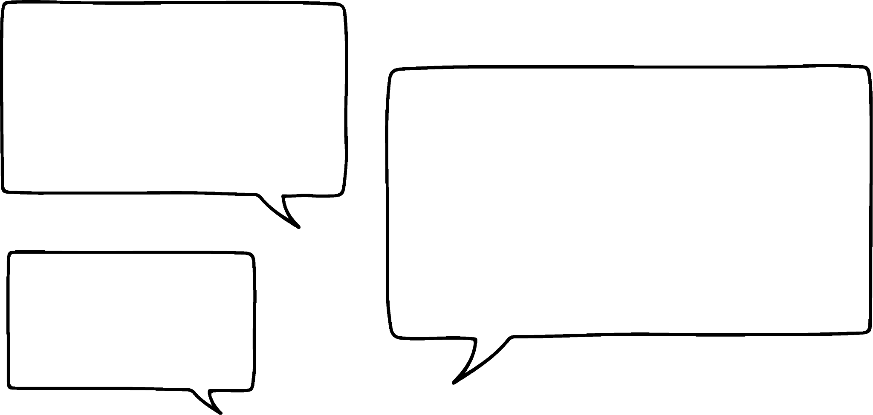



Shaxda natiijooyinka ee tijaabo laba heer ah (Natiijada table from a two-stage trial)
Tijaabo waa in la wareejiyo labada wareeg (spinners).
Waxaan samayn karnaa shax natiijooyin ah si aan u muujinno natiijooyinka suurtagalka ah.
C
A
B
wareegga 1 (spinner 1)
1
4
A
B
C
Ma muhiim tahay wareegga loo yaqaan 'spinner 1'?
2
3
1
A1
B1
C1
2
A2
B2
C2
wareegga 2 (spinner 2)
3
A3
B3
C3
Xaaladdan, maya. A1 iyo 1A waa isku natiijo.
4
A4
B4
C4
Saciid

Slide 9


Shaxda natiijooyinka ee tijaabo laba heer ah (Natiijada table from a two-stage trial)
Kee ka mid ah kuwan soo socda ayaa noqon kara shax natiijooyin ah labadan wareeg?
1
3
A
D
2
B
C
b
c
a
1
2
3
1
B
3
1
2
3
A
1A
2A
3A
A
1A
BA
3A
A
B
1B
2B
3B
2
12
B2
32
A1
B1
C1
D1
B
C
1C
2C
3C
C
1C
BC
3C
A2
B2
C2
D2
C
A3
B3
C3
D3
D
1D
2D
3D
D
1D
BD
3D
D

Slide 10
Shaxda natiijooyinka ee tijaabo laba heer ah (Natiijada table from a two-stage trial)
Ciyaar baa la ciyaarayaa halkaas oo wareegga ugu sarreeya uu guuleysto.
Suad iyo Nuur ayaa ciyaarta ciyaaraya, labadooduba waxay leeyihiin wareejiye (spinner).
1
2
3
Suad
Labadan natiijaba (outcomes) waa hal wareejiye (spinner) oo leh '1' iyo kan kale oo leh '2'.
1
2
3
guul ma jirto
Suad ayaa guuleysatay
Suad ayaa guuleysatay
1
Nuur ayaa guuleystay
guul ma jirto
Suad ayaa guuleysatay
Si kastaba ha ahaatee, qoondaynta (allocation) nambarka qofka ayaa hadda muhiim ah, si loo go'aamiyo cidda guuleysata.
Nuur
2
Nuur ayaa guuleystay
Nuur ayaa guuleystay
guul ma jirto
3

Slide 11
Shaxda natiijada (outcome table) ee tijaabada laba-tallaabo (two-stage trial)
Waa la ciyaarayaa ciyaar halkaas oo wadarta (total) labada wareejiye (spinner) ee wareejinta (spins) ay go'aamiso tirada tiriyeyaasha (counters) la soo ururiyay.
Shaxda natiijada (outcome table) waxay tusi kartaa wadarta (totals) suurtogalka ah, taas oo kuu ogolaanaysa inaad aragto suurtogalnimada (likelihood) helista tiradaas tiriyeyaasha (counters).
5
1
4
2
3
wareejin 1 (spin 1)
Tirada suurtogalka ah ee tiriyeyaasha (counters) waa {2, 3, 4, 5, 6, 7, 8, 9, 10}
1
2
3
4
5
1
2
3
4
5
6
2
3
4
5
6
7
Natiijooyinkan (outcomes) iskuma dhigma suurtogalnimada (equally likely).
wareejin 2 (spin 2)
3
4
5
6
7
8
4
5
6
7
8
9
5
6
7
8
9
10

Slide 12
Shaxda natiijada (outcome table) ee tijaabo laba heer ah (two-stage trial)
Labada wareejiye (spinners) waa la wareejin doonaa (spun) nambaradana waa la isku dhufan doonaa (multiplied). Buuxi shaxda natiijada (outcome table).
1
2
4
6
4
5
6
3
5
1
4
8
12
2
5
10
15
3
6
12
18

Slide 13
Shaxda natiijada (outcome table) ee tijaabo laba heer ah (two-stage trial)
1) Wareeggan (spinner) waxaa la wareejin doonaa laba jeer oo qayb ka mid ah tijaabo laba heer ah (two-stage trial). Buuxi shaxda natiijada (outcome table) si aad u muujiso dhammaan natiijooyinka suurtagalka ah.
A
B
C
A
C
A
B
B
C

Slide 14
Shaxda natiijada (outcome table) ee tijaabo laba heer ah (two-stage trial)
2) Labada wareeg (spinners) ayaa la wareejin doonaa qayb ka mid ah tijaabo laba heer ah (two-stage trial). Buuxi shaxda natiijada (outcome table) si aad u muujiso dhammaan natiijooyinka suurtagalka ah.
1
2
A
C
A
B
1
2
B
C

Slide 15
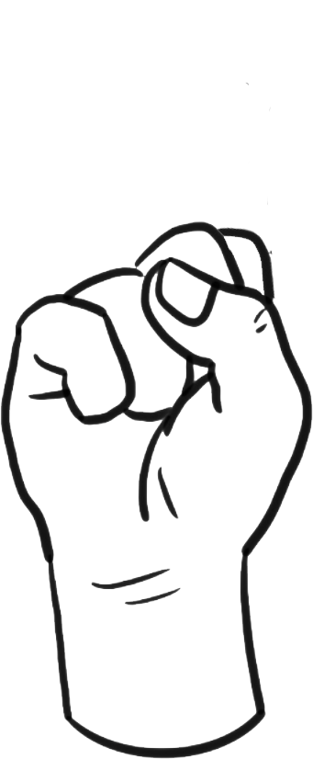

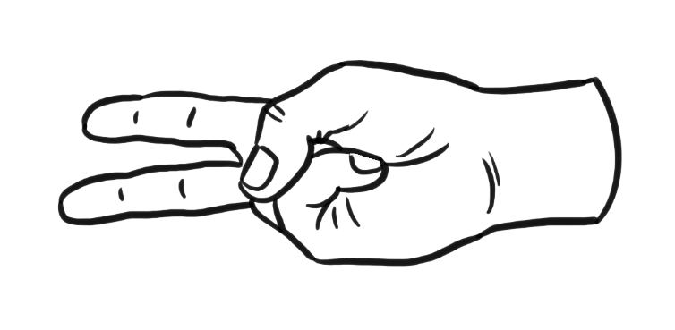



Shaxda natiijada (outcome table) ee tijaabo laba heer ah (two-stage trial)
3) Layla iyo Isra waxay ciyaarayaan ciyaarta 'dhagax, warqad, maqas' (rock, paper, scissors), halkaas oo dhagax uu ka adkaado maqas, maqas uu ka adkaado warqad, iyo warqad ay ka adkaato dhagax.
Buuxi shaxda natiijada (outcome table) si aad u muujiso marka qof kastaa guuleysto.
Layla
dhagax (rock)
warqad (paper)
maqas (scissors)
1
2
dhagax (rock)
Isra
warqad (paper)
maqas (scissors)

Slide 16
Shaxda natiijada (outcome table) ee tijaabo laba heer ah (two-stage trial)
1) Wareeggan (spinner) waxaa la wareejin doonaa laba jeer oo qayb ka mid ah tijaabo laba heer ah (two-stage trial). Buuxi shaxda natiijada (outcome table) si aad u muujiso dhammaan natiijooyinka suurtagalka ah.
A
B
C
A
C
A
AA
AB
AC
B
B
BA
BB
BC
C
CA
CB
CC

Slide 17
Shaxda natiijada (Natiijada table) ee tijaabo laba marxaladood (two-stage trial)
2) Labada wareeg (spinners) waa la wareejin doonaa qayb ka mid ah tijaabada laba marxaladood (two-stage trial). Buuxi shaxda natiijada (outcome table) si aad u muujiso dhammaan natiijooyinka suurtagalka ah.
1
2
A
C
A
A1
A2
B
1
2
B
B1
B2
C
C1
C2

Slide 18
Shaxda natiijada (Natiijada table) ee tijaabo laba marxaladood (two-stage trial)
3) Layla iyo Isra waxay ciyaarayaan ciyaarta 'dhagax, warqad, maqas' (rock, paper, scissors), halkaas oo dhagax (rock) ka adkaado maqas (scissors), maqas (scissors) ka adkaado warqad (paper), warqad (paper) ka adkaato dhagax (rock).
Buuxi shaxda natiijada (outcome table) si aad u muujiso goorta qof kasta uu guuleysto.
Layla
dhagax (rock)
warqad (paper)
maqas (scissors)
1
2
dhagax (rock)
qofna (no one)
Layla
Isra
Isra
warqad (paper)
Isra
qofna (no one)
Layla
maqas (scissors)
Layla
Isra
qofna (no one)

Slide 19
Isticmaalka shaxanka laba-geesoodka ah si loo muujiyo natiijooyinka laba dhacdo
Shaxda natiijooyinka ee tijaabo laba heer ah
Shaxda natiijooyinka ee laba dhacdo
Soo noqnoqoshada (Frequency) ee shaxanka laba-geesoodka ah

Slide 20
Shaxda natiijooyinka ee laba dhacdo
Haddii wareegtan la wareejiyo, natiijooyinka suurtagalka ah waa {1, 2, 3, 4, 5}.
Isra iyo Cabdi waxay ciyaarayaan ciyaar. Isra waxay heshaa dhibic haddii ay ku soo baxdo tiro kooban (prime number) Cabdina wuxuu heshaa dhibic haddii ay ku soo baxdo tiro aan caadi ahayn (odd number).
5
1
4
2
3
Shaxda natiijooyinka waxaa loo samayn karaa si loo kala saaro natiijooyinka suurtagalka ah.
ma aha tiro kooban (not a prime number)
tiro kooban (prime number)
tiro aan caadi ahayn (odd number)
3
1
5
ma aha tiro aan caadi ahayn (even)
2
4

Slide 21
Shaxda natiijooyinka ee laba dhacdo
Haddii wareegtan la wareejiyo, natiijooyinka suurtagalka ah waa {1, 2, 3, 4, 5}.
Isra iyo Cabdi waxay ciyaarayaan ciyaar. Isra waxay heshaa dhibic haddii ay ku soo baxdo tiro kooban (prime number) Cabdina wuxuu heshaa dhibic haddii ay ku soo baxdo tiro aan caadi ahayn (odd number).
5
1
4
2
3
Dhammaan natiijooyinka suurtagalka ah, goobta muunadda (sample space), waxaa lagu muujiyay shaxda natiijooyinka.
ma aha tiro koowaad (not a prime number)
tiro kooban (prime number)
tiro kisi (odd number)
3
1
5
ma aha tiro kisi (xataa) (not an odd number (even))
2
4

Slide 22
Jaantuska natiijada (outcome table) ee laba dhacdo (two events)
Isra iyo Cabdi waxay go'aansadeen inay beddelaan xeerarka ciyaartooda. Isra hadda waxay helaysaa dhibic (point) haddii wareejiyaha (spinner) ku soo baxo 'tiro xataa (even number)' Cabdi wuxuu helayaa dhibic (point) haddii wareejiyaha (spinner) ku soo baxo 'qaybiyaha 6 (factor of 6)'.
Buuxi jaantuska natiijada (outcome table).
5
1
4
2
3
ma aha qaybiyaha 6 (not a factor of 6)
qaybiyaha 6 (factor of 6)
tiro xataa (even number)
2
4
ma aha tiro xataa (kisi) (not an even number (odd))
1
5
3

Slide 23
Jaantuska natiijada (outcome table) ee laba dhacdo (two events)
Jaantuskan natiijada (outcome table) waxaa loo sameeyay laba dhacdo (two events) oo ka yimid tijaabo (trial).
Waa maxay booska muunadda (sample space) ee tijaabadan (trial)?
ma aha tiro labajibbaaran (not a square number)
tiro labajibbaaran (square number)
{1, 2, 3, 4, 5, 6, 7, 8, 9}
tiro kisi (odd number)
1
3
5
Waa kuwee labada dhacdo (two events)?
9
7
Dhacdada 1 (Event 1) = tirooyinka kisi (odd numbers) = {1, 3, 5, 7, 9}
ma aha tiro kisi (xataa) (not an odd number (even))
4
2
6
Dhacdada 2 (Event 2) = tirooyinka labajibbaaran (square numbers) = {1, 4, 9}
8
Kee ka mid ah natiijooyinka (outcomes) ayaa ku jira labada dhacdo (both events)?
{1, 9}

Slide 24
Shaxda natiijada (Natiijada table) ee laba dhacdo (events)
Isticmaal jaantuskan natiijada (outcome table) si aad u qorto booska muunadda (sample space).
ma aha faktor (factor) ee 12
faktor (factor) ee 12
Meel saami (Sample space) = {1, 2, 3, 4, 5, 6, 7, 8, 9}
3
6
9
tiro badan (multiple) ee 3
ma aha tiro badan (multiple) ee 3
1
2
5
7
4
8

Slide 25
Shaxda natiijada (Natiijada table) ee laba dhacdo (events)
1) Wareegga (spinner) waa la wareejin doonaa. Labada dhacdo (events) waa tirooyinka siman (even numbers) iyo faktorrada (factors) ee 14.
Buuxi shaxdan natiijada (outcome table) si aad u muujiso natiijooyinka dhacdo kasta.
1
8
2
7
3
6
4
5
tirooyinka siman (even numbers)
tirooyinka khafifka ah (odd numbers)
faktorrada (factors) ee 14
ma aha faktorrada (factors) ee 14

Slide 26









Shaxda natiijada (Natiijada table) ee laba dhacdo (events)
2) Kala saar cabitaannadan shaxda natiijada (outcome table).
A
B
C
D
E
F
G
H
I
gacanta (handle)
gacanta la'aan (no handle)
balo (straw)
balo la'aan (no straw)

Slide 27
Shaxda natiijada (Natiijada table) ee laba dhacdo (events)
1) Wareegga (spinner) waa la wareejin doonaa. Labada dhacdo (events) waa tirooyinka siman (even numbers) iyo faktorrada (factors) ee 14.
Buuxi shaxdan natiijada (outcome table) si aad u muujiso natiijooyinka dhacdo kasta.
1
8
2
7
3
6
4
5
tirooyin siman (even numbers)
tirooyin kisi (odd numbers)
tirooyinka qaybiyaha 14 (factors of 14)
2
1
7
ma aha qaybiyayaasha 14 (not factors of 14)
4
6
8
3
5

Slide 28
Shaxda natiijada ee laba dhacdo (Natiijada table from two events)
2) Kala saar cabitaannadan shaxda natiijada.
A
B
C
D
E
F
G
H
I
gacan (handle)
gacan la'aan (no handle)
B
C
F
D
E
H
baloog (straw)
I
baloog la'aan (no straw)
A
G

Slide 29
Isticmaalka shaxda laba-geesoodka ah si loo muujiyo natiijooyinka laba dhacdo (Using two-way tables to display outcomes for two events)
Shaxda natiijada ee tijaabo laba-tallaabo ah (Natiijada table from a two-stage trial)
Shaxda natiijada ee laba dhacdo (Natiijada table from two events)
Inta jeer ee shaxda laba-geesoodka ah (Frequency in a two-way table)

Slide 30
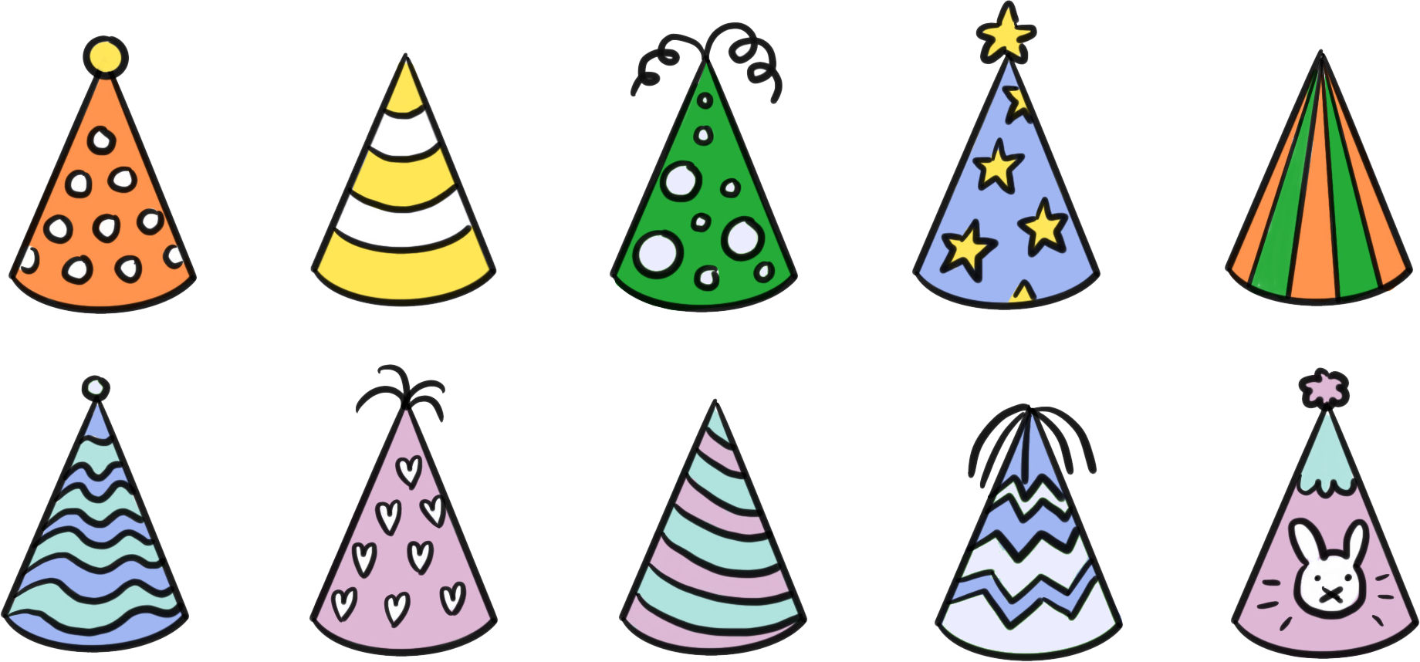
Inta jeer ee shaxda laba-geesoodka ah (Frequency in a two-way table)
Waa kuwan koofiyadaha xafladda ee xirmada.
aan xariiqaysnayn (not striped)
xariiqaysan (striped)
dusha sare (topper)
Qaar ka mid ah waxaa loo sheegi karaa inay yihiin kuwa xariiqaysan (striped).
Qaar ka mid ah waxaa loo sheegi karaa inay leeyihiin dusha sare (toppers).
Waxaan u kala saari karnaa shax natiijada oo ku salaysan dusha sare iyo xariijimaha.
aan topper lahayn (no topper)

Slide 31
Soo noqnoqosho (Frequency) ee jaantus laba-jibaaran (two-way table)
aan xariijimo lahayn (not striped)
Halkii aan haysan lahayn koofiyadaha xafladda, waxaan diirada saari karnaa soo noqnoqoshada (frequency).
xariijimo leh (striped)
topper
2
Waxaa jira laba koofiyadood oo xaflad, kuwaas oo labaduba xariijimo leh (striped) iyo topper leh.
aan topper lahayn (no topper)
Waxaan sii wadi karnaa tirinta soo noqnoqoshada (frequencies) si aan u dhisno jaantus soo noqnoqosho (frequency table).

Slide 32
Soo noqnoqosho (Frequency) ee jaantus laba-jibaaran (two-way table)
aan xariijimo lahayn (not striped)
xariijimo leh (striped)
wadarta (total)
Haddii aan sii wadno tirinta sidan, waxaan ku dhammeeynaa jaantuskan soo noqnoqosho (frequency table).
topper
2
4
6
aan topper lahayn (no topper)
3
1
4
wadarta (total)
5
5
10

Slide 33


Soo noqnoqosho (Frequency) ee jaantus laba-jibaaran (two-way table)
Axmed wuxuu qabanqaabinayaa raffle samafal. Tigidhuhu waa huruud, buluug, ama casaan, mid walbana wuxuu leeyahay lambar 3-godoodle ah. Wuxuu go'aansaday inuu tixgeliyo laba dhacdo: in tigidhku yahay huruud (Y), iyo in tigidhku leeyahay lambar khayaali ah (odd).
Wuxuu si qayb ahaan u buuxiyay jaantuskan laba-jibbaaran (two-way table).
Ma jiraan macluumaad ku filan oo lagu dhammaystiro?
Y
aan Y ahayn (not Y)
wadarta (total)
khayaali (odd)
6
20
aan khayaali ahayn (not odd (even))
Haa. Tigidhadu waa 'odd' ama 'not odd', taas oo macneheedu yahay wadarta (total) 'odd' (20) iyo wadarta (total) 'not odd' (19) waxay siinaysaa tirada guud ee tigidhada raffle-ka (39).
13
19
wadarta (total)
39

Slide 34
Joogtaynta (Frequency) jaantuska laba-jibbaaran (two-way table)
Axmed wuxuu qabanqaabinayaa raffle samafal. Tigidhadu waa yellow, blue ama pink mid kastana wuxuu leeyahay lambar 3-god (3 digit). Wuxuu go'aansaday inuu tixgeliyo laba dhacdo (events): in tigidhku yahay yellow (Y), iyo in tigidhku leeyahay lambar odd ah.
Wuxuu si qayb ahaan u buuxiyay jaantuskan laba-jibbaaran (two-way table).
Ma jiraan macluumaad ku filan oo lagu dhammaystiro?
Y
not Y
wadarta (total)
odd
6
14
20
not odd (even)
Marka waxaan ognahay inay jiraan wadar (total) 20 tigidh oo 'odd' ah, oo 6 ka mid ah yihiin 'yellow'. Tani waxay ka dhigan tahay in 14 tigidh oo 'odd' ah ay yihiin 'not yellow'.
13
19
wadarta (total)
39

Slide 35
Joogtaynta (Frequency) jaantuska laba-jibbaaran (two-way table)
Axmed wuxuu qabanqaabinayaa raffle samafal. Tigidhada waa huruud, buluug ama casaan, mid kastana wuxuu leeyahay lambar 3-god ah. Wuxuu go'aansaday inuu tixgeliyo laba dhacdo: in tigidhku yahay huruud (Y), iyo in tigidhku leeyahay lambar khayaali ah.
Wuxuu si qayb ahaan u buuxiyay jaantuskan laba-jibbaaran (two-way table).
Ma jiraan macluumaad ku filan oo lagu dhammaystiro?
Y
not Y
wadarta (total)
khayaali (odd)
6
14
20
aan khayali ahayn (even)
Sidoo kale, waxaa jira 19 tigidh oo 'not odd' ah, 13 ka mid ahna waa 'not yellow', taas oo macneheedu yahay in 6 ka mid ah tigidhada 'not odd' ay yihiin 'yellow'.
6
13
19
wadarta (total)
39

Slide 36
Soo noqnoqoshada (Frequency) ee jaantus laba-jibbaaran (two-way table)
Axmed wuxuu qabanqaabinayaa raffle samafal. Tigidhada waa huruud, buluug ama casaan, mid kastana wuxuu leeyahay lambar 3-god ah. Wuxuu go'aansaday inuu tixgeliyo laba dhacdo: in tigidhku yahay huruud (Y), iyo in tigidhku leeyahay lambar khayaali ah.
Wuxuu si qayb ahaan u buuxiyay jaantuskan laba-jibbaaran.
Ma jiraan macluumaad ku filan oo lagu dhammaystiro?
Sida jaantuskan laba-jibbaaran loo buuxiyay waxay noqon kartaa mid ka duwan.
Haddii aad taqaan laba qiime (value) oo ku yaal saf ama tiir kasta, waxaad heli kartaa qiimaha saddexaad.
Qiimaha ugu dambeeya wuxuu had iyo jeer u shaqayn karaa is-hubin (self check) iyadoo laga xisaabinayo safka iyo tiirka labadaba si loo hubiyo inay isku mid yihiin.
Y
aan Y ahayn
wadarta (total)
khayaali (odd)
6
14
20
aan khayali ahayn (even)
Kadib, tirada guud ee tigidhada 'huruud' waa la xisaabin karaa, iyo tirada guud ee tigidhada 'aan huruud ahayn' waa la xisaabin karaa.
6
13
19
wadarta (total)
12
27
39
Hubi inay isku darkoodu yihiin wadarta guud. 12 + 27 = 39 ✔

Slide 37
Soo noqnoqoshada (Frequency) ee jaantus laba-jibbaaran (two-way table)
Halkan waxaa ah jaantus laba-jibbaaran oo qayb ahaan buuxsamay oo ku saabsan cabbirka kabaha iyo kooxda sanadka ee dugsiga. Kee ayaa marka hore la xisaabin karaa?
Tirada ardayda 'sanadka 9' ee leh cagaha 'aan ahayn size 7'.
a
size 7
aan size 7 ahayn
wadarta (total)
Tirada guud ee ardayda 'sanadka 9'.
sanadka 9
64
b
ma aha sanadka 9
552
714
Tirada ardayda 'ma aha sanadka 9' ee cagta 'size 7' leh.
c
wadarta (total)
601
d
Tirada guud ee ardayda.

Slide 38
Joogtaynta (Frequency) ee shaxda laba-geesoodka ah (two-way table)
1) Tusaale (sample) random ah oo dadka ah ayaa la xulayaa iyadoo loo qoondeeyo tiro (integer) 1 ilaa 50 qof kasta, ka dibna lagu xulayo laba xeer. Xeerka 1 waa in tirada (integer) ay tahay tiro-ku-dhufasho (multiple) 10, xeerka 2 waa in tirada (integer) ay tahay tiro-ku-dhufasho (multiple) 4.
tiro-ku-dhufasho (multiple) 10
ma aha tiro-ku-dhufasho (multiple) 10
wadarta (total)
Buuxi shaxda laba-geesoodka ah (two-way table).
tiro-ku-dhufasho (multiple) 4
ma aha tiro-ku-dhufasho (multiple) 4
wadarta (total)
50

Slide 39





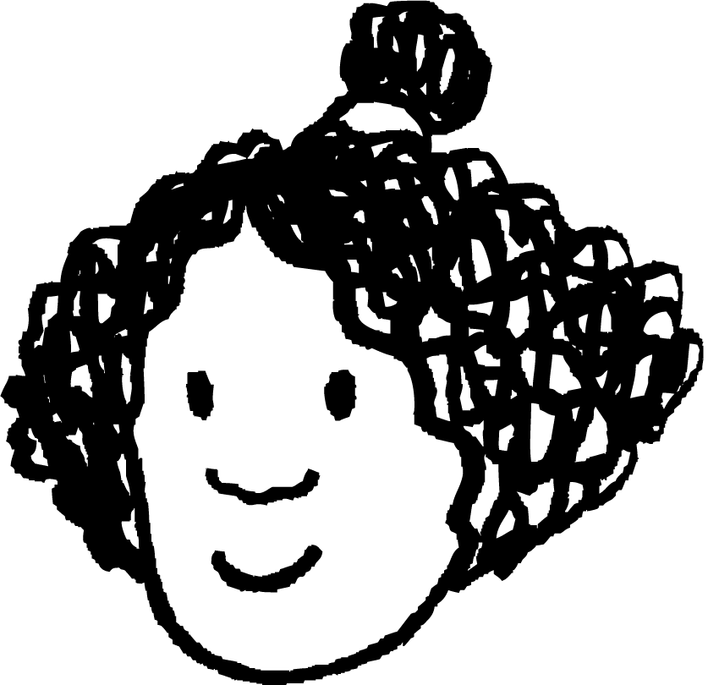
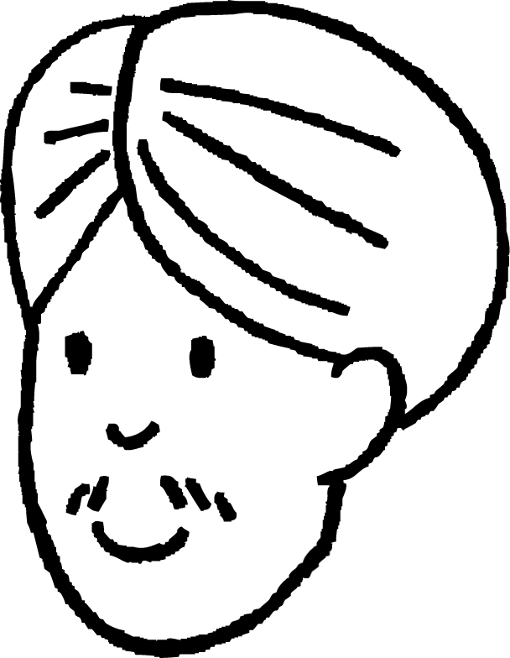
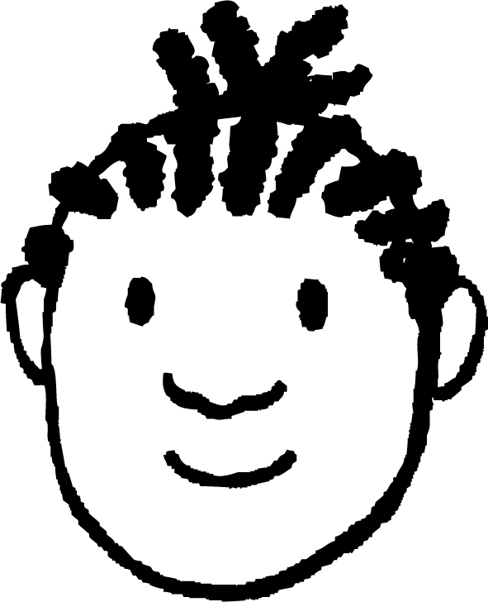
Joogtaynta (Frequency) ee shaxda laba-geesoodka ah (two-way table)
10 arday ayaa la weydiiyay inay xubno ka yihiin naadiga ciyaaraha ama muusikada.
2)
Caasha | Muusig (Music) | Ciyaaraha (Sport)
Cali | Muusig (Music)
Isra
Yacquub | Ciyaaraha (Sport)
Nuur | Muusig (Music) | Ciyaaraha (Sport)
Cabdi | Muusig (Music) | Ciyaaraha (Sport)
Layla | Muusig (Music)
Saciid | Muusig (Music)
Axmed | Ciyaaraha (Sport)
Suad | ? | ?
a) Goobo ku wareeji dhammaan tirooyinka shaxda ku jira ee ay ku jirto Isra.
b) Naadiyada ay samayso Suad, haddii ay jiraan?
naadiga (club) ciyaaraha
naadi (club) ciyaaraha ma leh
wadarta (total)
naadiga (club) muusikada
3
4
7
naadi (club) muusikada ma leh
2
1
3
wadarta (total)
5
5
10

Slide 40
Inta jeer ee shaxda laba-geesoodka ah (Frequency in a two-way table)
3)
Buuxi sanduuqyada maqan ee shaxdan laba-geesoodka ah.
a)
b)
 | Isku dayga 1aad | Isku dayga 2aad | wadarta (total)
gudub (pass) | 12
guuldarro (fail) |  | 6 | 22
wadarta (total) |  | 16
 | cunug (child) | qof weyn (adult) | wadarta (total)
muraayadaha (goggles) |  |  | 23
muraayad la'aan (no goggles) |  | 31
wadarta (total) |  | 36 | 63

Slide 41
Inta jeer ee shaxda laba-geesoodka ah (Frequency in a two-way table)
1) Dad si aan kala sooc lahayn ayaa loo xulayaa iyadoo loo qoondeeyo tiro (integer) 1 ilaa 50 qof kasta, ka dibna lagu xusho laba sharci. Sharci 1 waa in tiro (integer) uu yahay tiro-dhufasho (multiple) 10, sharci 2-na waa in tiro (integer) uu yahay tiro-dhufasho (multiple) 4.
tiro-dhufasho (multiple) 10
ma aha tiro-dhufasho (multiple) 10
wadarta (total)
Buuxi jaantuska laba-geesoodka ah (two-way table).
tiro-dhufasho (multiple) 4
2
10
12
aan ahayn tiro-iska leh 4 (multiple of 4)
3
35
38
wadarta (total)
5
45
50

Slide 42
Soo noqnoqoshada (Frequency) ee jaantuska laba-geesoodka ah (two-way table)
10 arday ayaa la weydiiyay inay xubno ka yihiin naadi ciyaar (Sport) ama muusig (Music).
2)
Caasha (Aisha) | Muusik (Music) | Isboorti (Sport)
Cali (Andeep) | Muusik (Music)
Isra (Izzy)
Yacquub (Jacob) | Isboorti (Sport)
Nuur (Jun) | Muusig (Music) | Ciyaar (Sport)
Cabdi | Muusig (Music) | Ciyaar (Sport)
Layla | Muusig (Music)
Saciid | Muusig (Music)
Axmed | Ciyaar (Sport)
Suad | Muusig (Music)
a) Goobo ku wareeji dhammaan tirooyinka ku jira jaantuska ee ay ku jirto Isra.
b) Suad waxay qabataa naadiyada kee, haddii ay jiraan?
naadiga isboortiga (sports club)
ma jiro naadiga isboortiga (no sports club)
wadarta (total)
naadiga muusikada (music club)
3
4
7
ma jiro naadiga muusikada (no music club)
2
1
3
wadarta (total)
5
5
10

Slide 43
Joogtaynta (Frequency) ee shaxda laba-jibbaaran (two-way table)
3)
Buuxi sanduuqyada maqan ee shaxdan laba-jibbaaran (two-way table) kasta.
a)
b)
 | Isku day 1aad | Isku day 2aad | wadarta (total)
gudub (pass) | 12 | 10 | 22
guuldarro (fail) | 16 | 6 | 22
wadarta (total) | 28 | 16 | 44
 | ilmo (child) | qof weyn (adult) | wadarta (total)
muraayadaha ilaalinta (goggles) | 18 | 5 | 23
muraayad la'aan (no goggles) | 9 | 31 | 40
wadarta (total) | 27 | 36 | 63

Slide 44
Isticmaalka miisaska laba jiho (two-way tables) si loo muujiyo natiijooyinka labada dhacdo (events)
Natiijooyinka waxaa lagu qori karaa miis natiijo (outcome table).
Tijaabo laba heer ah (two-stage trial), heerka koowaad waa tiirarka, kan kale waa safafka. Meesha natiijooyinka (sample space) waa natiijooyinka lagu muujiyay gudaha shaxda. Waa hab nidaamsan oo lagu dhiso meesha natiijooyinka (sample space).
Labo dhacdo (events) oo ka yimaada tijaabo, meesha natiijooyinka (sample space) waxaa loo kala saari karaa iyadoo loo eego dhacdooyinka (events).
Marka soo noqnoqoshada (frequencies) lagu muujiyo miis laba jiho (two way table), waxaa suurtagal ah in la helo qiimayaasha (values) maqan iyadoo la isticmaalayo wadarta (totals) tiirarka iyo safafka.

