Slide 1
Qorista tirooyinka waaweyn ee qaabka caadiga ah (standard form)
Qaabka caadiga ah (standard form)

Slide 2
Sida agabkeena waxbarista loogu talagalay fasalka

Slide 3
Waxaan qori karaa tirooyin aad u waaweyn oo qaab caadi ah (standard form) waxaanan qiimeeyaa macnaha nolosha dhabta ah ee qaabkan si fiican loogu isticmaalo.

Slide 4

Marka tiro lagu dhufto nafteeda marar badan, waxaa loo qori karaa si ka fudud qaab jibbaar ah (exponential form).
e.g.
Sharciga isku-xirnaanta (associative law) wuxuu sheegayaa in ku celcelinta hawlgalku ay soo saarto natiijo isku mid ah si kasta oo lammaaneyaasha qiimaha (values) loo kooxeeyo. Waxaan ku kooxeyn karnaa iyagoo adeegsanaya qawska (brackets).
Tusaalooyin
Tusaale ma aha
2.4 × 100 =
(48 ÷ 6) ÷ 2 =
4
2.4 × 10 × 10
24 ÷ 6
7 + 10
3 + (4 + 10) =
(3 + 4) + 10
48 ÷ (6 ÷ 2) =
16
48 ÷ 3

Slide 5
Qaabka caadiga ah (standard form) - tan waxaa lagu qeexi doonaa darsiga

Slide 6

Qorista tirooyinka waaweyn ee qaabka caadiga ah (standard form)
Qorista tirooyinka waaweyn ee qaabka caadiga ah (standard form)
Qaabka caadiga ah (standard form) ilaa caadiga
Qaabka caadiga ah (standard form) ee xisaabiyaha (calculator)

Slide 7
Qorista tirooyinka waaweyn ee qaabka caadiga ah (standard form)
Siyaabo badan oo aad u qori kartid tirokan?
573 × 100 000 000 000
573 × 10¹¹
57.3 × 10¹²
57 300 000 000 000
0.573 × 10¹⁴
5.73 × 10¹³
57 300 × 10⁹
573 × 100 × 10⁹
Waxaa laga yaabaa inaad ka fikirtay kuwa kale.
Mid ka mid ah kuwan ayaa ku qoran qaab caadi ah (standard form).

Slide 8
Qorista tirooyinka waaweyn ee qaabka caadiga ah (standard form)
Kan waa tiro ku qoran qaab caadi ah (standard form).
573 × 100 000 000 000
573 × 10¹¹
57.3 × 10¹²
57 300 000 000 000
0.573 × 10¹⁴
5.73 × 10¹³
57 300 × 10⁹
573 × 100 × 10⁹
Maxay tahay waxa aad u malaynaysaa in qaabka caadiga ah (standard form) macneheedu yahay?

Slide 9
Qorista tirooyinka waaweyn ee qaabka caadiga ah (standard form)
Qaabka caadiga ah (standard form) waa marka tiro loo qoro qaab A × 10n, (halkaas oo 1 ≤ A < 10 iyo n uu yahay tiro isku-dhafan (integer)).
57 300 000 000 000
5.73 × 10¹³

Slide 10
Qorista tirooyinka waaweyn ee qaabka caadiga ah (standard form)
Maxay tahay sababta aad u malaynayso in qorista tiro qaab caadi ah (standard form) ay faa'iido u leedahay?
Tusaale ahaan,
680 000 000 000 = 6.8 × 10¹¹
Saxnimada tirada (accuracy) lama luminayo
Waqti badan ayay qaadataa in la qoro
Suurtagalnimada qalad marka la koobiyeynayo dhammaan tirooyinka (digits)
Waa gaaban oo kooban

Slide 11


Qorista tirooyinka waaweyn ee qaabka caadiga ah (standard form)
Kuwee ka mid ah kuwan soo socda ayaa loo qoray qaab caadi ah oo sax ah (correct standard form)? Sharax sababta kuwa kale si khaldan loogu qoray.
9.8 × 10⁴
Kani waa qaab caadi ah oo sax ah (correct standard form).
a
89.2 × 10⁹
Kani waa khalad sababtoo ah tirada 89.2 > 10
b
0.016 × 10¹²
Kani waa khalad sababtoo ah 0.016 < 1
c
d
1.2456 × 10²
Kani waa qaab caadi ah oo sax ah (correct standard form).

Slide 12
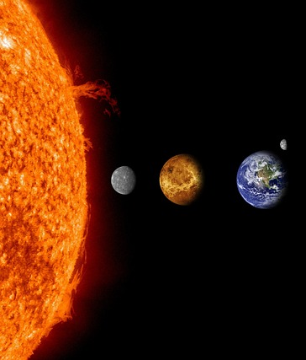

Qorista tirooyinka waaweyn ee qaabka caadiga ah (standard form)
Fogaanta Dhulka iyo Qorraxdu waxay qiyaas ahaan tahay 150 bilyan mitir (metres).
Aynu isticmaalno jaantuska qiimaha meesha (place value chart) si aan u tuso sida tirooyinkani u ekaanayaan.

Slide 13
Qorista tirooyinka waaweyn ee qaabka caadiga ah (standard form)
Masaafada dhulka ilaa qorraxdu waa qiyaastii 150 bilyan mitir.
HB
TB
B
HM
TM
M
HTh
TTh
Th
H
T
O
t
10¹¹
10¹⁰
10⁹
10⁸
10⁷
10⁶
10⁵
10⁴
10³
10²
10¹
10⁰
10⁻¹
1 5 0 0 0 0 0 0 0 0 0 0
Gelinta nambarka jaantuska qiimaha meesha (place value chart),
maxaad u malaynaysaa inuu yahay qaabka caadiga ah (standard form)?

Slide 14
Qorista tirooyinka waaweyn qaabka caadiga ah (standard form)
Qorista qaabka caadiga ah (standard form) wuxuu bixiyaa 1.5 × 1011
HB
TB
B
HM
TM
M
HTh
TTh
Th
H
T
O
t
10¹¹
10¹⁰
10⁹
10⁸
10⁷
10⁶
10⁵
10⁴
10³
10²
10¹
10⁰
10⁻¹
1 5 0 0 0 0 0 0 0 0 0 0
Masaafada dhulka ilaa qorraxdu waa qiyaastii 150 bilyan mitir.

Slide 15
Qorista tirooyinka waaweyn qaabka caadiga ah (standard form)
Isticmaalka jaantuska qiimaha meesha (place value chart) waa hab aad u fiican oo lagu arko tirada oo loo beddelo qaabka caadiga ah (standard form), laakiin waa waqti qaadasho.
Aan aragno haddii aan heli karno hab aan la'aan jaantuska qiimaha meesha (place value chart).
HB
TB
B
HM
TM
M
HTh
TTh
Th
H
T
O
t
10¹¹
10¹⁰
10⁹
10⁸
10⁷
10⁶
10⁵
10⁴
10³
10²
10¹
10⁰
10⁻¹
1 5 0 0 0 0 0 0 0 0 0 0

Slide 16
Qorista tirooyinka waaweyn ee qaabka caadiga ah (standard form)
Tirade (digit) ugu horreysa ee muhiimka (significant figure) waxay gashaa tiirka kow (ones column), tirada (digits) kalena sidaas ku xigta.
Maxaynu ku dhufanaynaa 1.5 si aan u helno 150 bilyan?
10¹¹
HB
TB
B
HM
TM
M
HTh
TTh
Th
H
T
O
t
10¹¹
10¹⁰
10⁹
10⁸
10⁷
10⁶
10⁵
10⁴
10³
10²
10¹
10⁰
10⁻¹
1 5 0 0 0 0 0 0 0 0 0 0
1 5

Slide 17
Qorista tirooyinka waaweyn ee qaabka caadiga ah (standard form)
Shaxda qiimaha meesha (place value chart) la'aanteed, sidee kale u heli kartaa jibbaarka (exponent) ee 11?
Waa tirada isku dhufashada (multiplications) ee 10 loo baahan yahay si tirade (digit) tiirka kow (ones column) ugu jirto tiirka saxda ah. Aynu tirinno.
1 5 0 0 0 0 0 0 0 0 0 0
1 5

Slide 18
Qorista tirooyinka waaweyn ee qaabka caadiga ah (standard form)
Waxaa jira 11 isku dhufasho (multiplications) oo 10 ah oo loo baahan yahay laga bilaabo tiirka kow (ones column).
1 ≤ A < 10
Marka jawaabtu waa 1.5 × 1011
1 5 0 0 0 0 0 0 0 0 0 0
1 5

Slide 19
Qorista tirooyinka waaweyn ee qaabka caadiga ah (standard form)
Shaxda qiimaha meesha (place value chart) la'aanteed, u qor 956 000 000 qaabka caadiga ah (standard form).
956 000 000
9.56
Si aad u sawirto maskaxdaada, saf tirooyinka (digits) tiirka kow (ones column)

Slide 20
Qorista tirooyinka waaweyn qaabka caadiga ah (standard form)
Iyada oo aan la isticmaalin jaantuska qiimaha (place value), ku qor 956 000 000 qaabka caadiga ah (standard form).
956 000 000
9.56
Immisa jeer lagu dhuftey 10?

Slide 21
Qorista tirooyinka waaweyn qaabka caadiga ah (standard form)
Iyada oo aan la isticmaalin jaantuska qiimaha (place value), ku qor 956 000 000 qaabka caadiga ah (standard form).
956 000 000
9.56
Iyada oo aan la isticmaalin jaantuska qiimaha (place value), ku qor 780 000 qaabka caadiga ah (standard form).
780 000
7.8
Si aad u aragto, saf tirooyinka tiirka kow (ones column)
Waxaa jiray 8 jeer oo lagu dhuftey 10 laga bilaabo tiirka kow (ones column).
9.56 × 10⁸

Slide 22
Qorista tirooyinka waaweyn qaabka caadiga ah (standard form)
Iyada oo aan la isticmaalin jaantuska qiimaha (place value), ku qor 956 000 000 qaabka caadiga ah (standard form).
956 000 000
9.56
Iyada oo aan la isticmaalin jaantuska qiimaha (place value), ku qor 780 000 qaabka caadiga ah (standard form).
780 000
7.8
Immisa jeer boodbood ama lagu dhuftey 10?
Waxaa jiray 8 jeer oo lagu dhuftey 10 laga bilaabo tiirka kow (ones column).
9.56 × 10⁸

Slide 23
Qorista tirooyinka waaweyn qaabka caadiga ah (standard form)
Iyada oo aan la isticmaalin jaantuska qiimaha (place value), ku qor 956 000 000 qaabka caadiga ah (standard form).
956 000 000
9.56
Iyada oo aan la isticmaalin jaantuska qiimaha (place value), ku qor 780 000 qaabka caadiga ah (standard form).
780 000
7.8
Waxaa jiray 8 jeer oo lagu dhuftey 10 laga bilaabo tiirka kow (ones column).
Waxaa jiray 5 jeer oo lagu dhuftey 10 laga bilaabo tiirka kow (ones column).
9.56 × 10⁸
7.8 × 10⁵

Slide 24
Qorista tirooyinka waaweyn qaabka caadiga ah (standard form)
Iyada oo aan la isticmaalin jaantuska qiimaha (place value), u beddel kuwan soo socda qaabka caadiga ah (standard form).
15 000
566 000 000
9 800 000 000
156 100
563 000 000 000 000 000
100 200 000 000

Slide 25
Writing large numbers in standard form
2) Saddex arday oo waxaa la siiyay 905 000 000 000 si ay u beddelaan qaab caadi ah. Sheeg halka ay ku qaladeen oo bixi jawaabta saxda ah.
905 000 000 000
Jawaabta: 905 × 109
905 000 000 000
Jawaabta: 9.5 × 1011
905 000 000 000
Answer: 9.05 × 10¹⁰

Slide 26
Writing large numbers in standard form
3) Sharax sababta qaabka caadiga ah u muhiim yahay.

Slide 27
Writing large numbers in standard form
Without using a place value chart, convert the following into standard form.
= 1.5 × 10⁴
15 000
566 000 000
9 800 000 000
156 100
563 000 000 000 000 000
100 200 000 000
= 5.66 × 10⁸
= 9.8 × 10⁹
= 1.561 × 10⁵
= 5.63 × 10¹⁷
= 1.002 × 10¹¹

Slide 28
Writing large numbers in standard form
2) Saddex arday oo waxaa la siiyay 905 000 000 000 si ay u beddelaan qaab caadi ah. Sheeg halka ay ku qaladeen oo bixi jawaabta saxda ah.
905 000 000 000
Answer: 905 × 10⁹
905 000 000 000
Answer: 9.5 × 10¹¹
905 000 000 000
Answer: 9.05 × 10¹⁰
Qaybta koowaad ee qaabka caadiga ah waa inay leedahay tiro u dhaxaysa 1 iyo 10, oo ay ku jirto 1, laakiin aysan ku jirin 10.
(1 ≤ A < 10)
Si khaldan ayaa loo tiriyey tirada isku dhufashada 10. Waxaa jira 11 isku dhufasho oo 10 ah.
In order to correctly obtain 905 000 000 000, there must be a multiplication of powers of 10 to 9.05 not 9.5
Correct: 9.05 × 10¹¹

Slide 29
Writing large numbers in standard form
3) Sharax sababta qaabka caadiga ah u muhiim yahay.
We write a number in standard form because it is easier, concise and more efficient to write numbers in this way.
It reduces errors. It would take too long to write huge numbers and there would be more room for error when writing a number in its ordinary form.
Qaabka caadiga ah wuxuu u oggolaanayaa tiro kasta in loo qoro iyadoo la adeegsanayo hab caadi ah, sida A × 10n halkaas oo 1 ≤ A < 10 iyo n uu yahay tiro isku mid ah.
When writing in a concise form, it is easier to use in calculations.

Slide 30
Qorista tirooyinka waaweyn ee qaabka caadiga ah (standard form)
Qorista tirooyinka waaweyn ee qaabka caadiga ah (standard form)
Qaabka caadiga ah (standard form) ee tiro caadi ah
Qaabka caadiga ah (standard form) ee xisaabiyaha (calculator)

Slide 31
Qaabka caadiga ah (standard form) ee tiro caadi ah
Tirada (Number) | Qaabka jibbaarada (Exponential form)
1
10
100
1000
10 000
100 000
1 000 000
Aynu u beddelno tiro ku qoran qaabka caadiga ah (standard form) oo noqoto tiro caadi ah
U beddel 2.3 × 103 tiro caadi ah.
Marka la eego × 103 oo matalaysa × 1000, waxaan ognahay inay tahay
2.3 × 1000 = 2300
10⁰
10¹
10²
10³
10⁴
10⁵
10⁶

Slide 32

Qaabka caadiga ah (standard form) ee tiro caadi ah
Geli calaamad (tick) agtooda weedhaha saxda ah. Halka jawaabtu khaldan tahay, qor tirada caadiga ah ee saxda ah.
5.63 × 10⁷ = 563 000 000
Tirada saxda ah 56 300 000
a
2.3 × 10⁴ = 230 000
Tirada saxda ah 23 000
b
7.05 × 10⁴ = 75 000
Tirada saxda ah 70 500
c
d
7.02 × 10⁶ = 7 020 000

Slide 33
Qaabka caadiga ah (standard form) ee tiro caadi ah
U qor kuwan tirada caadiga ah.
1.8 × 10³
1.39 × 10⁵
3.93 × 10⁷
4.413 × 10⁸
e) 8.02 × 10³
f) 5.001 × 10⁵
g) 1.2345 × 10⁷
h) 7.00004 × 10⁸

Slide 34
Qaabka caadiga ah (standard form) ee tiro caadi ah
U qor kuwan tirada caadiga ah.
1.8 × 10³
1.39 × 10⁵
3.93 × 10⁷
4.413 × 10⁸
e) 8.02 × 10³
f) 5.001 × 10⁵
g) 1.2345 × 10⁷
h) 7.00004 × 10⁸
= 1 800
= 8020
= 139 000
= 500 100
= 39 300 000
= 12 345 000
= 441 300 000
= 700 004 000

Slide 35
Qorista tirooyinka waaweyn ee qaabka caadiga ah (standard form)
Qorista tirooyinka waaweyn ee qaabka caadiga ah (standard form)
Qaabka caadiga ah (standard form) ee tiro caadi ah
Qaabka caadiga ah (standard form) ee xisaabiyaha (calculator)

Slide 36
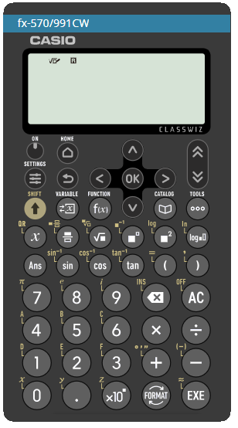
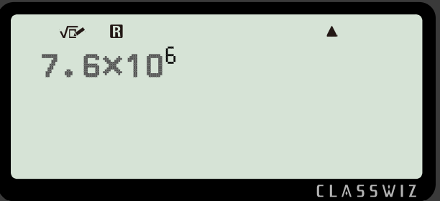
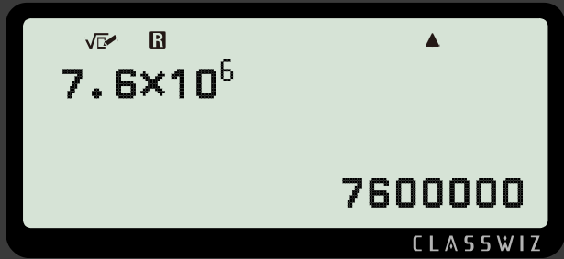

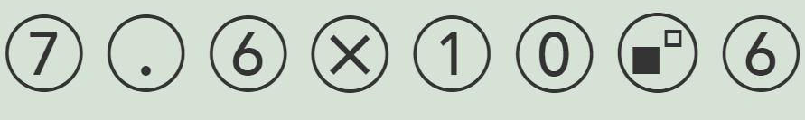

Qaabka caadiga ah (standard form) ee xisaabiyaha (calculator)
Hadda aan isticmaalno xisaabiyaha (calculator) si aan u bedelno
7.6 × 10⁶ oo loo bedelo tiro caadi ah (ordinary number)
Isticmaalka gelinta (input)
Riixida ama
waxay soo saartaa natiijada (output) inay tahay
7 600 000

Slide 37

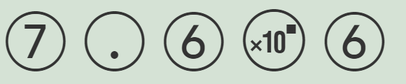
Qaabka caadiga ah (standard form) ee xisaabiyaha (calculator)
Tusaale ahaan, aan gelino (input)
7.6 × 10⁶
Isticmaalka gelinta (input)
Riixida ama
waxay soo saartaa natiijada (output) inay tahay
7 600 000

Slide 38
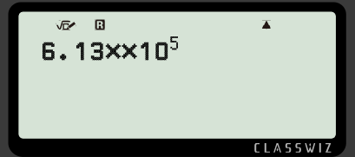

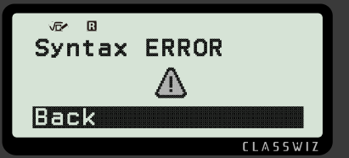
Qaabka caadiga ah (standard form) ee xisaabiyaha (calculator)
Layla waxay gelisaa (input) xisaabtan xisaabiyaha (calculator).
Maxay u malaynaysaa in natiijada (output) noqon doonto?
Layla waxay isticmaashay laba isku dhufasho (multiplications) marka natiijadu (output) waa qalad (error).

Slide 39
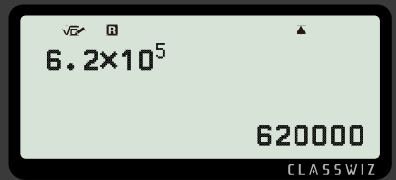
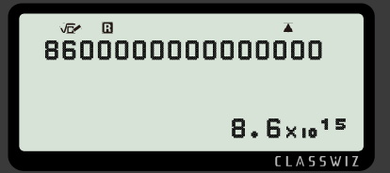
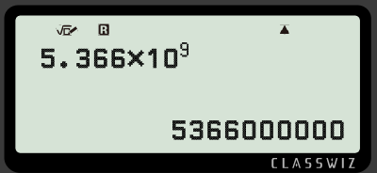
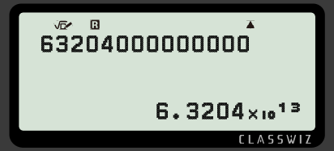
Qaabka caadiga ah (standard form) ee xisaabiyaha (calculator)
Buuxi macluumaadka maqan.
a)
c)
b)
d)

Slide 40
Qaabka caadiga ah (standard form) ee xisaabiyaha (calculator)
2) Baar goorta tirada noqoto mid aad u weyn oo xisaabiyaha (calculator) u bedelo qaabka caadiga ah (standard form).

Slide 41
Qaabka caadiga ah (standard form) ee xisaabiyaha (calculator)
Buuxi macluumaadka maqan.
a)
c)
b)
d)

Slide 42
Qaabka caadiga ah (standard form) ee kalkuleetarka (calculator)
2) Baar (Investigate) marka tirada ay noqoto mid aad u weyn oo kalkuleetarka (calculator) u beddelo qaabka caadiga ah (standard form).
Tiro kasta oo ku taal shaashadda oo ka badan 9 godan (digits) waxaa loo beddelaa qaabka caadiga ah (standard form).

Slide 43
Qorista tirooyinka waaweyn ee qaabka caadiga ah (standard form)
Waxaan u qornaa tiro qaabka caadiga ah (standard form) sababtoo ah waa sahlan, kooban, oo wax ku ool ah in tirooyinka loo qoro sidan.
Haddii aynaan u qorin tirooyinka waaweyn qaabka caadiga ah (standard form), waxay qaadan lahayd waqti dheer in la qoro tirooyinka waaweyn, waxaana jiri lahayd meel badan oo khalad (error) ah marka la qorayo tiro qaabkeeda caadiga ah.
Qaabka caadiga ah (standard form) wuxuu u oggolaanayaa tiro kasta in loo qoro iyadoo la adeegsanayo hal hab oo caadi ah, sida A × 10n, (halkaas oo 1 ≤ A < 10 iyo n uu yahay tiro isku-dhafan (integer)).

