Slide 1
Qorista tirooyinka yaryar ee qaabka caadiga ah (standard form)
Qaabka caadiga ah (standard form)

Slide 2
Sida agabkeena waxbarista loogu talagalay fasalka

Slide 3
Waxaan qori karaa tirooyin aad u yar oo ah A × 10n (halkaas oo 1 ≤ A < 10) waxaanan qiimeeyaa macnaha nolosha dhabta ah ee qaabkan faa'iidada laga helo.

Slide 4

Marka tiro lagu dhufto nafteeda marar badan, waxaa loo qori karaa si fudud qaab jibbaar ah (exponential form).
e.g.
Sharciga isku-xirka (associative law) wuxuu sheegayaa in ku celcelinta hawlgalku ay soo saarto natiijo isku mid ah iyadoo aan loo eegin sida lammaaneyaasha qiimaha (values) loo kooxeeyo. Waxaan ku kooxayn karnaa anagoo adeegsanayna xero (brackets).
Tusaalooyin (Examples)
Tusaale ma aha (Non examples)
2.4 × 100 =
(48 ÷ 6) ÷ 2 =
4
2.4 × 10 × 10
24 ÷ 6
7 + 10
3 + (4 + 10) =
(3 + 4) + 10
48 ÷ (6 ÷ 2) =
16
48 ÷ 3

Slide 5
Qaabka caadiga ah (standard form) waa marka tiro loo qoro qaab A × 10n, (halkaas oo 1 ≤ A < 10 iyo n waa tiro dhammaystiran (integer)).

Slide 6

Qorista tirooyinka yaryar ee qaabka caadiga ah (standard form)
Qorista tirooyinka aad u yaryar ee qaabka caadiga ah (standard form)
U beddelka qaabka caadiga ah (ordinary) iyo qaabka caadiga ah (standard form)
Qaabka caadiga ah (standard form) ee xisaabiyaha (calculator)

Slide 7
Qorista tirooyinka aad u yaryar ee qaabka caadiga ah (standard form)
Jajab tobanle (decimal) ayaa loo qoray dhammaan qaababkan.
Ma ogaan kartaa waa maxay jajabka tobanle (decimal)?
Waa 0.021
Waxaa jira tiro aan dhamaad lahayn oo habab ah oo loo qoro 0.021, laakiin kaliya hal hab oo qaabka caadiga ah (standard form) ah. Isticmaalka hab caadi ah si loo qoro tirooyin aad u yaryar waa muhiim.

Slide 8

Qorista tirooyinka aad u yaryar ee qaabka caadiga ah (standard form)
Isticmaalka qaabka caadiga ah (standard form) ee tirooyinka waaweyn ama yaryar waa heshiis (convention).
Tani waa sababta oo ah ma dooneyno in tiro loo qoro siyaabo kala duwan oo badan, maxaa yeelay tani waxay noqon kartaa mid jahawareer leh.

Slide 9
Qorista tirooyin aad u yar oo qaabka caadiga ah (standard form)
Isticmaalka qaabka caadiga ah (standard form) ee tirooyinka waaweyn ama yaryar waa heshiis (convention).
A × 10n halkaas oo 1 ≤ A < 10, n-na yahay tiro (integer).
A waa inay tahay tiro u dhaxaysa 1 iyo 10, oo ay ku jirto 1, laakiin 10 kuma jiro.
n wuxuu noqon karaa tiro (whole number) togan ama taban.

Slide 10
Qorista tirooyin aad u yar oo qaabka caadiga ah (standard form)
Isticmaalka jaantuska qiimaha meesha (place value chart) waa hab fiican oo lagu sawiro tirada oo loo beddelo qaabka caadiga ah (standard form), laakiin wuxuu qaataa waqti.
0 | 0 | 0
0 | 0 | 6
1 | 9
O
t
h
th
tth
hth
m
tm
hm
b
10⁰
10⁻¹
10⁻²
10⁻³
10⁻⁴
10⁻⁵
10⁻⁶
10⁻⁷
10⁻⁸
10⁻⁹

Slide 11
Qorista tirooyin aad u yar oo qaabka caadiga ah (standard form)
Isticmaalka jaantuska qiimaha meesha (place value chart),
maxay tahay fikraddaada tiradan qaabkeeda caadiga ah (standard form)?
6.19 × 10⁻⁵
0 | 0 | 0
0 | 0 | 6
1 | 9
O
t
h
th
tth
hth
m
tm
hm
b
10⁰
10⁻¹
10⁻²
10⁻³
10⁻⁴
10⁻⁵
10⁻⁶
10⁻⁷
10⁻⁸
10⁻⁹
Aynu eegno haddii aan heli karno hab aan jaantuska qiimaha meesha (place value chart) la'aan.

Slide 12
Qorista tirooyinka aad u yar ee qaabka caadiga ah (standard form)
Jaantuska qiimaha meesha (place value chart) la'aan, sidee ku u qornaa qaabka caadiga ah (standard form)?
Marka hore, adigoo isticmaalaya lambarrada 6, 1 iyo 9, waxaan samaynaynaa tiro si loo buuxiyo
1 ≤ A < 10
Marka waxaan ognahay in qaabka caadiga ah (standard form) uu ekaado sidan ilaa hadda
6.19 × 10⬜
0 . 0 0 0 0 6 1 9
6 . 1 9

Slide 13

Qorista tirooyinka aad u yar ee qaabka caadiga ah (standard form)
Hadda, waxaan tirinay inta jeer ee isku dhufashada aan u isticmaalno si aan uga helno 6.19 ilaa 0.000 061 9
×
×
×
×
×
Tani waxay ka dhigan tahay 6.19 = 0.000 061 9
Qaabka caadiga ah (standard form) 6.19 × 10−5 = 0.000 061 9
0 . 0 0 0 0 6 1 9
6 . 1 9

Slide 14
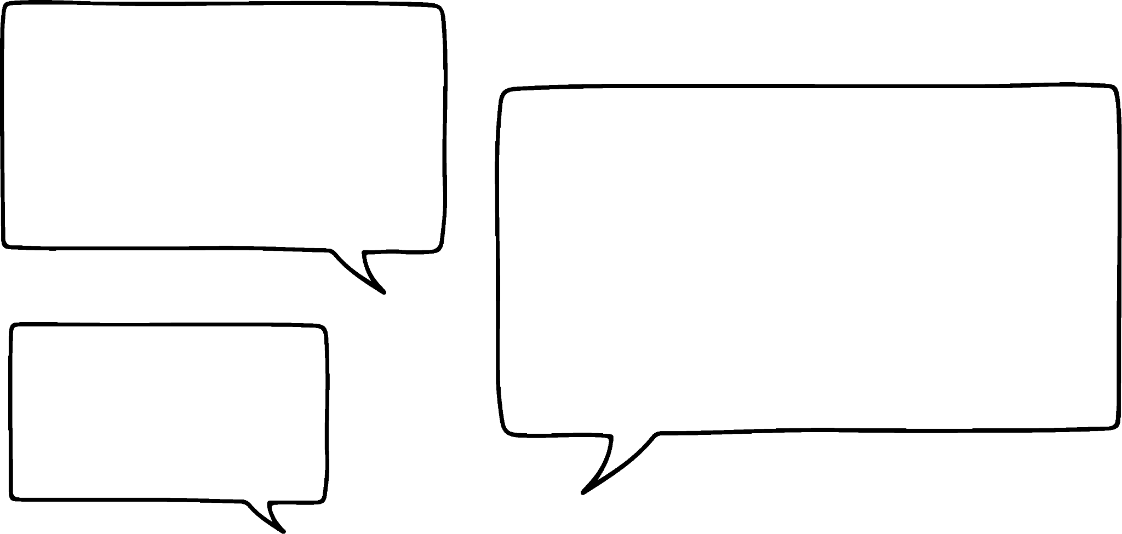
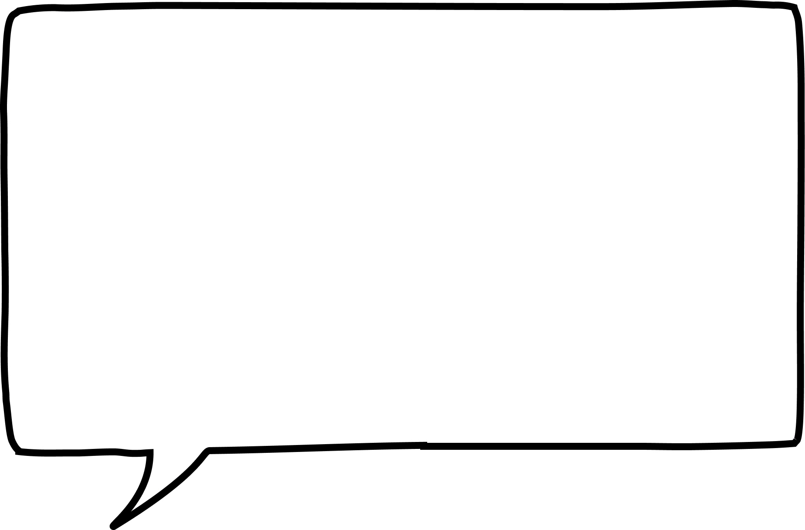



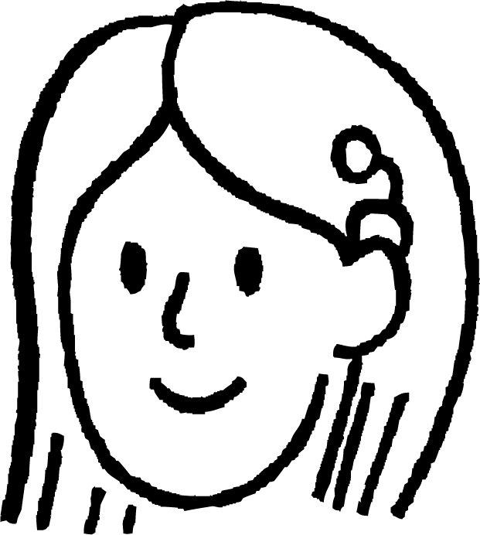


Qorista tirooyinka aad u yar ee qaabka caadiga ah (standard form)
Layla waxay tidhaahdaa waxay taqaan wado gaaban.
Ma sharxi kartaa sababta wadada gaaban ee Layla u shaqeyso tirooyinka yar?
Tirooyinka yar, jibbaarka (exponent) taban (negative) wuxuu kuu sheegayaa inay yar tahay, tirada jibbaarkuna waxay kuu sheegaysaa inta eber (zero) ee la dhigo.
Waan arkayaa sidaas darteed 1.24 × 10−3 wuxuu leeyahay jibbaar (exponent) taban (negative), marka waan ogahay inay yar tahay. Tirada jibbaarka (exponent) waa 3 marka waxaa jira 3 eber (zero).
0.00124
Layla
Suad
Marka tiro si sax ah loogu qoro qaabka caadiga ah (standard form), jibbaarka (exponent) taban (negative) waa tirada qaybinta (divisions) ee 10.

Slide 15
Qorista tirooyinka aad u yar ee qaabka caadiga ah (standard form)
U beddel kuwan tiro caadi ah:
1.82 × 10⁻⁴
9.6 × 10⁻²
5.15 × 10⁻⁷
1.035 × 10⁻³
6.0045 × 10⁻¹⁰
= 0.000 182
= 0.096
= 0.000 000 515
= 0.001 035
= 0.000 000 000 600 45

Slide 16
Qorista tirooyinka aad u yar ee qaabka caadiga ah (standard form)
1) Adigoo isticmaalaya jaantusyada qiimaha meesha (place value), ku qor kuwan qaabka caadiga ah (standard form).
a)
0 | 0 | 0
0 | 6 | 9
O
t
h
th
tth
hth
10⁰
10⁻¹
10⁻²
10⁻³
10⁻⁴
10⁻⁵
b)
0 | 0 | 1
2 | 8
O
t
h
th
tth
hth
10⁰
10⁻¹
10⁻²
10⁻³
10⁻⁴
10⁻⁵

Slide 17
Qorista tirooyinka aad u yar ee qaabka caadiga ah (standard form)
2) Kuwa soo socda midkee aan qaabka caadiga ah (standard form) ku jirin? Sharax sababta.
a) 123 × 10⁻⁹
b) 1.24 × 10⁻³
c) 0.96 × 10⁻¹
d) 12 300 ÷ 10¹⁰
e) 0.059 × 10⁸

Slide 18
Qorista tirooyinka aad u yar ee qaabka caadiga ah (standard form)
3) Adigoon isticmaalin jaantuska qiimaha meesha (place value chart), kuwan soo socda u qor qaabka caadiga ah (standard form).
0.000 000 354
0.001 45
0.000 000 000 563
0.048 6
0.000 000 000 631

Slide 19
Qorista tirooyinka aad u yar ee qaabka caadiga ah (standard form)
Adigoo isticmaalaya jaantusyada qiimaha meesha (place value charts), kuwan soo socda u qor qaabka caadiga ah (standard form).
a)
0 | 0 | 0
0 | 6 | 9
O
t
h
th
tth
hth
10⁰
10⁻¹
10⁻²
10⁻³
10⁻⁴
10⁻⁵
6.9 × 10⁻⁴
b)
0 | 0 | 1
2 | 8
O
t
h
th
tth
hth
1.28 × 10⁻²
10⁰
10⁻¹
10⁻²
10⁻³
10⁻⁴
10⁻⁵

Slide 20
Qorista tirooyinka aad u yar ee qaabka caadiga ah (standard form)
2) Kuwa soo socda midkee aan qaabka caadiga ah (standard form) ku jirin? Sharax sababta.
a) 123 × 10⁻⁹
b) 1.24 × 10⁻³
c) 0.96 × 10⁻¹
d) 12 300 ÷ 10¹⁰
e) 0.059 × 10⁸
Kani waa qalad sababtoo ah 123 waa inuu noqdaa tiro qancisa 1 ≤ A < 10
Kani waa qaabka caadiga ah (standard form) ee saxda ah.
Kani waa qalad sababtoo ah 0.96 waa inuu noqdaa tiro qancisa 1 ≤ A < 10
Kani waa qalad sababtoo ah qaabka caadiga ah (standard form) wuxuu isticmaalaa isku dhufasho (multiplication).
Kani waa qalad sababtoo ah 0.059 waa inuu noqdaa tiro qancisa 1 ≤ A < 10

Slide 21
Qorista tirooyinka aad u yar ee qaabka caadiga ah (standard form)
3) Iyada oo aan la isticmaalin jaantuska qiimaha (place value), ku qor kuwan qaabka caadiga ah (standard form).
= 3.54 × 10⁻⁷
0.000 000 354
0.001 45
0.000 000 000 563
0.048 6
0.000 000 000 631
= 1.45 × 10⁻³
= 5.63 × 10⁻¹⁰
= 4.86 × 10⁻²
= 6.31 × 10⁻¹⁰

Slide 22
Qorista tirooyinka yar qaabka caadiga ah (standard form)
Qorista tirooyinka aad u yar qaabka caadiga ah (standard form)
Beddelka u dhexeeya qaabka caadiga ah iyo qaabka caadiga ah (standard form)
Qaabka caadiga ah (standard form) ee xisaabiyaha (calculator)

Slide 23

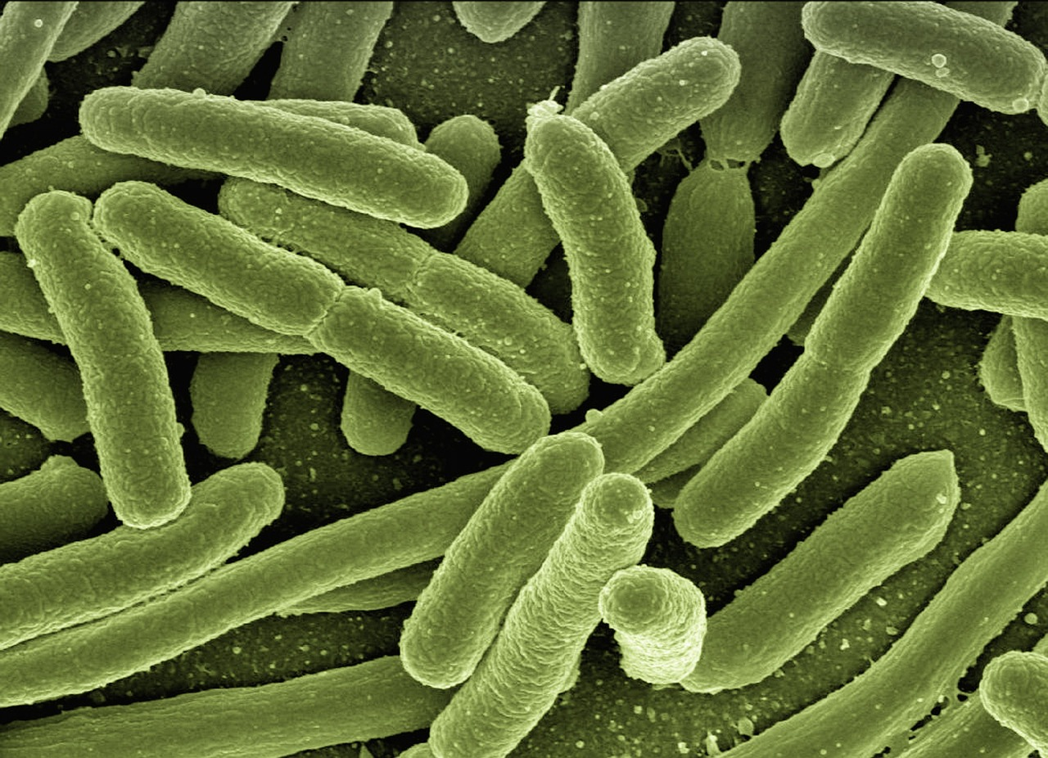

Beddelka u dhexeeya qaabka caadiga ah iyo qaabka caadiga ah (standard form)
Bixi tusaalooyin nolol dhab ah oo aan u isticmaalno tirooyin aad u yar.
Nanotechnology
Bayoloji (Biology) ama mikrobiyoloji (microbiology) − fiirinta noolaha, unugyada (cells) iwm.
Microchips-ku waxay qayb ka yihiin qalab kasta oo elektaroonik ah oo adduunka oo dhan ah

Slide 24
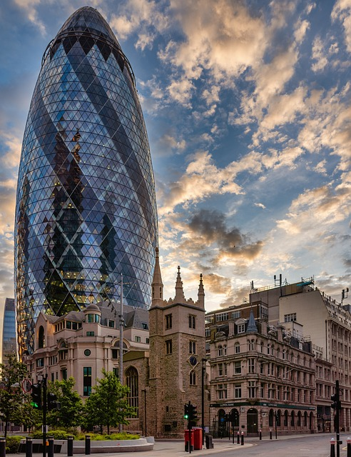

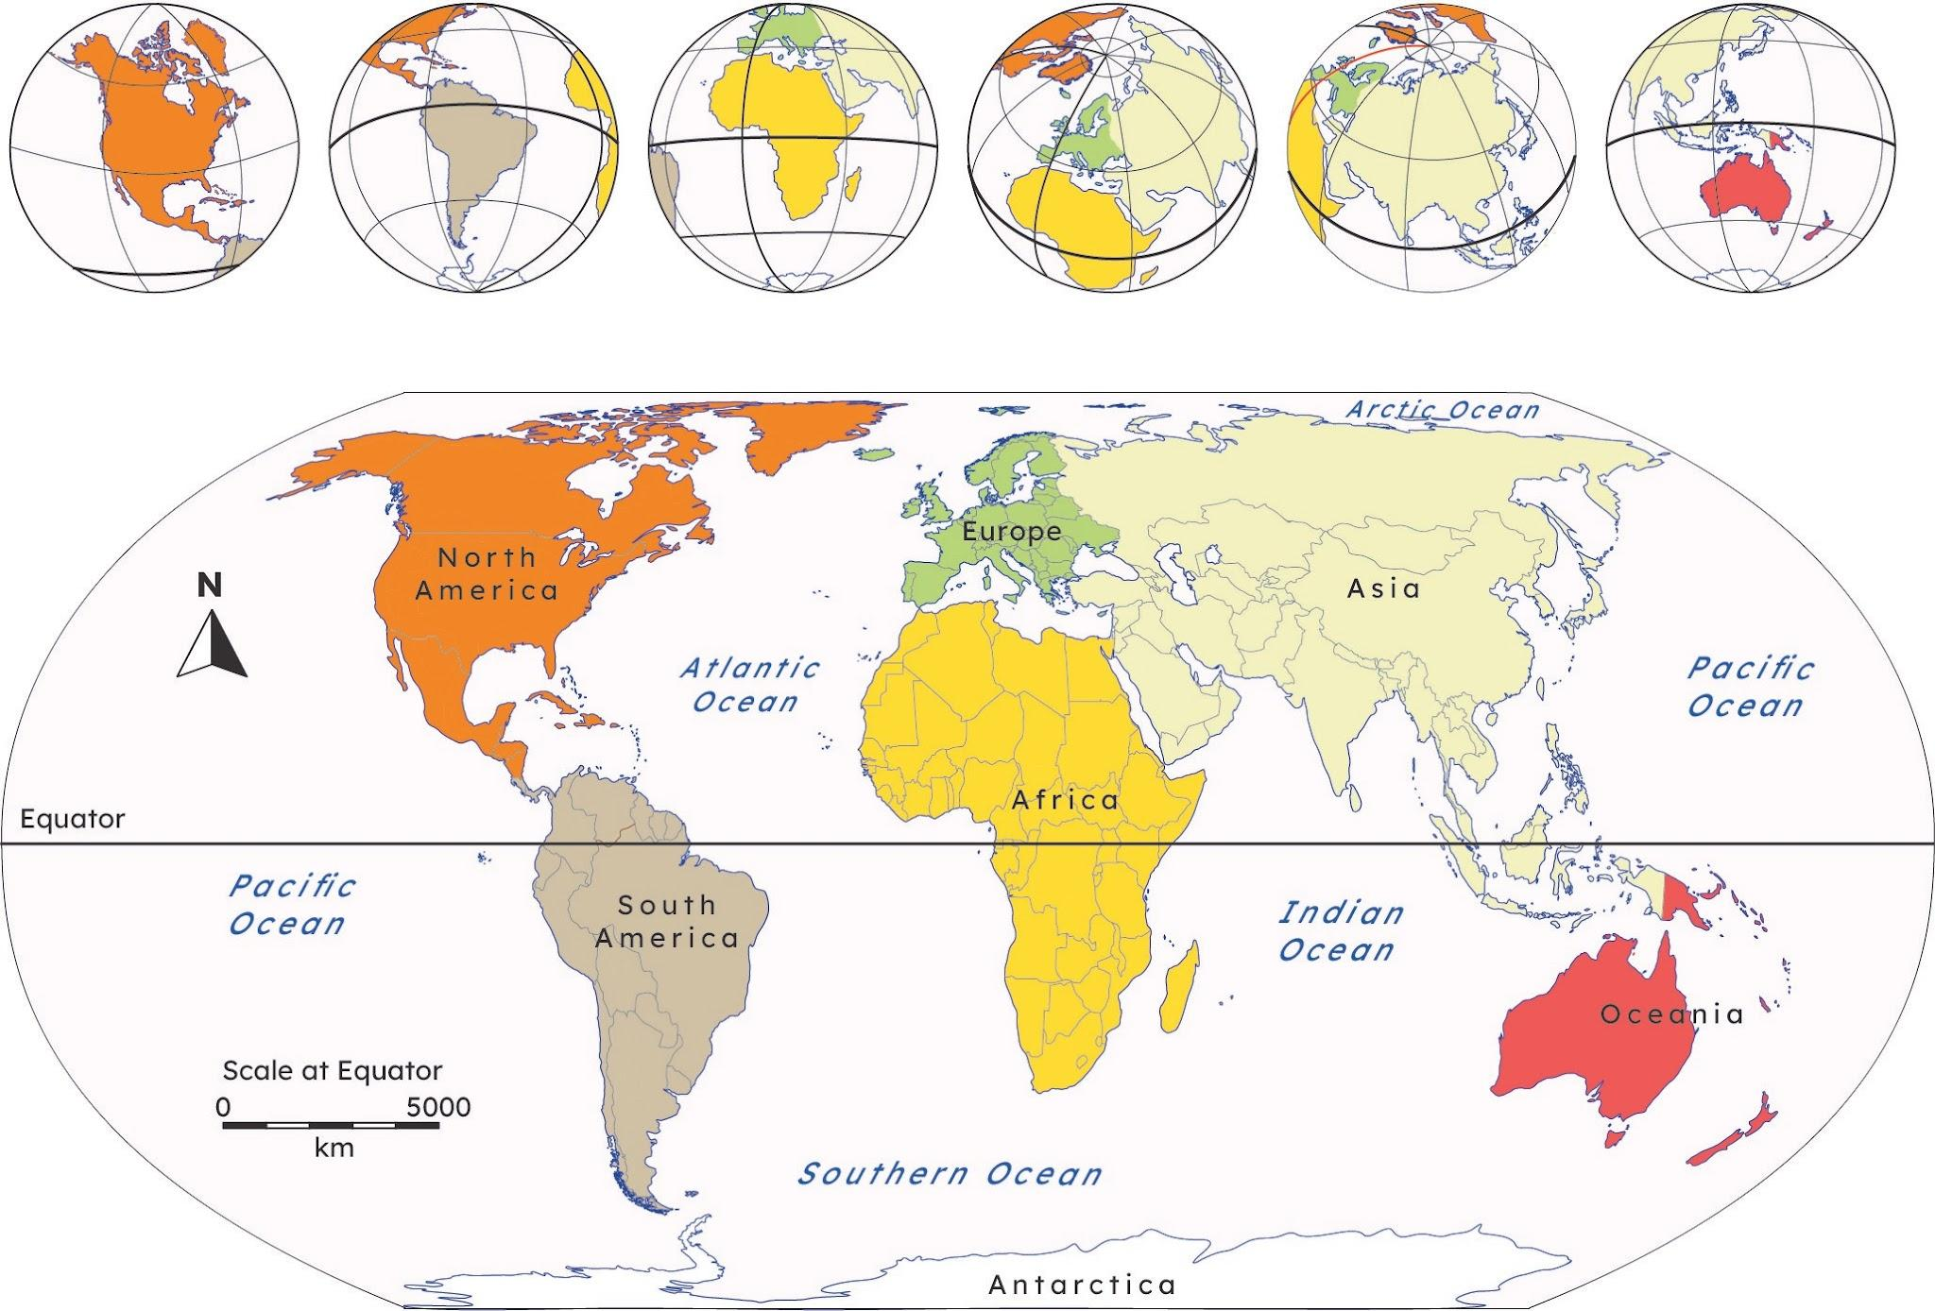
Beddelka u dhexeeya qaabka caadiga ah iyo qaabka caadiga ah (standard form)
Bixi tusaalooyin nolol dhab ah oo aan u isticmaalno tirooyin aad u waaweyn.
Tirooyinka caalamiga ah tusaale ahaan dadka, masaafada, lacagaha
Dhismaha iyo injineernimada (engineering)
Astronomy halkaas oo loo baahan yahay cabbiro aad u weyn

Slide 25
Beddelka u dhexeeya qaabka caadiga ah iyo qaabka caadiga ah (standard form)
Qaar ka mid ah ardaydu waxay xaliyeen su'aalahan. Sheeg inay sax yihiin iyo in kale oo sharax sababta.
780 000 qaabka caadiga ah (standard form).
780 000
7.8
92 300 qaabka caadiga ah (standard form).
92 300
92.3
Waxaa jiray 5 isku dhufasho oo 10 ah oo ka yimid tiirka kow (ones column).
Waxaa jiray 3 isku dhufasho oo 10 ah oo ka yimid tiirka kow (ones column).
Jawaabaha:
7.8 × 10⁵
92.3 × 10³

Slide 26
U beddelidda qaabka caadiga ah iyo qaabka jaantuska (standard form)
Qaar ka mid ah ardaydu waxay xaliyeen su'aalahan. Sheeg inay sax yihiin iyo in kale oo sharax sababta.
780 000 oo ku jira qaabka jaantuska (standard form).
780 000
7.8
Tani waa sax.
Waxay abuureen tiro 7.8 iyagoo isticmaalaya lambarrada 7 iyo 8 kuwaas oo qanciya 1 ≤ A < 10.
Waxay si sax ah u tiriyeen tirada isku dhufashada 10 si ay 7.8 uga dhigmaan 780 000
Waxaa jiray 5 isku dhufasho oo 10 ah oo laga soo bilaabo tiirka kow (ones column).
7.8 × 10⁵

Slide 27
U beddelidda qaabka caadiga ah iyo qaabka jaantuska (standard form)
Ardayda qaar ayaa xisaabiyay jawaabaha su'aalahan. Gee inay sax yihiin iyo in kale oo sharax sababta.
Tani waa qalad.
Waxay abuureen tiro 92.3 iyagoo isticmaalaya lambarrada 9, 2 iyo 3 kuwaas oo aan qancin 1 ≤ A < 10.
Waxay tiriyeen tirada isku dhufashada 10 si ay 92.3 uga dhigmaan 92 300
92 300 oo ku jira qaabka jaantuska (standard form).
92 300
92.3
Waxaa jiray 3 isku dhufasho oo 10 ah oo laga soo bilaabo tiirka kow (ones column).
92.3 × 10³

Slide 28
U beddelidda qaabka caadiga ah iyo qaabka jaantuska (standard form)
U beddel kuwan soo socda qaabka jaantuska (standard form).
0.000 000 263
652 000 000
0.005 63
892 000 000 000
0.000 000 000 000 000 3
30 004 000
0.000 300 4

Slide 29
U beddelidda qaabka caadiga ah iyo qaabka jaantuska (standard form)
2) U beddel kuwan soo socda tirooyinka caadiga ah (ordinary numbers).
2.31 × 10⁴
6.153 × 10⁻⁵
9.1565 × 10⁻⁶
2.48 × 10⁵
2.48 × 10⁻⁵
3.0065 × 10⁻⁹

Slide 30
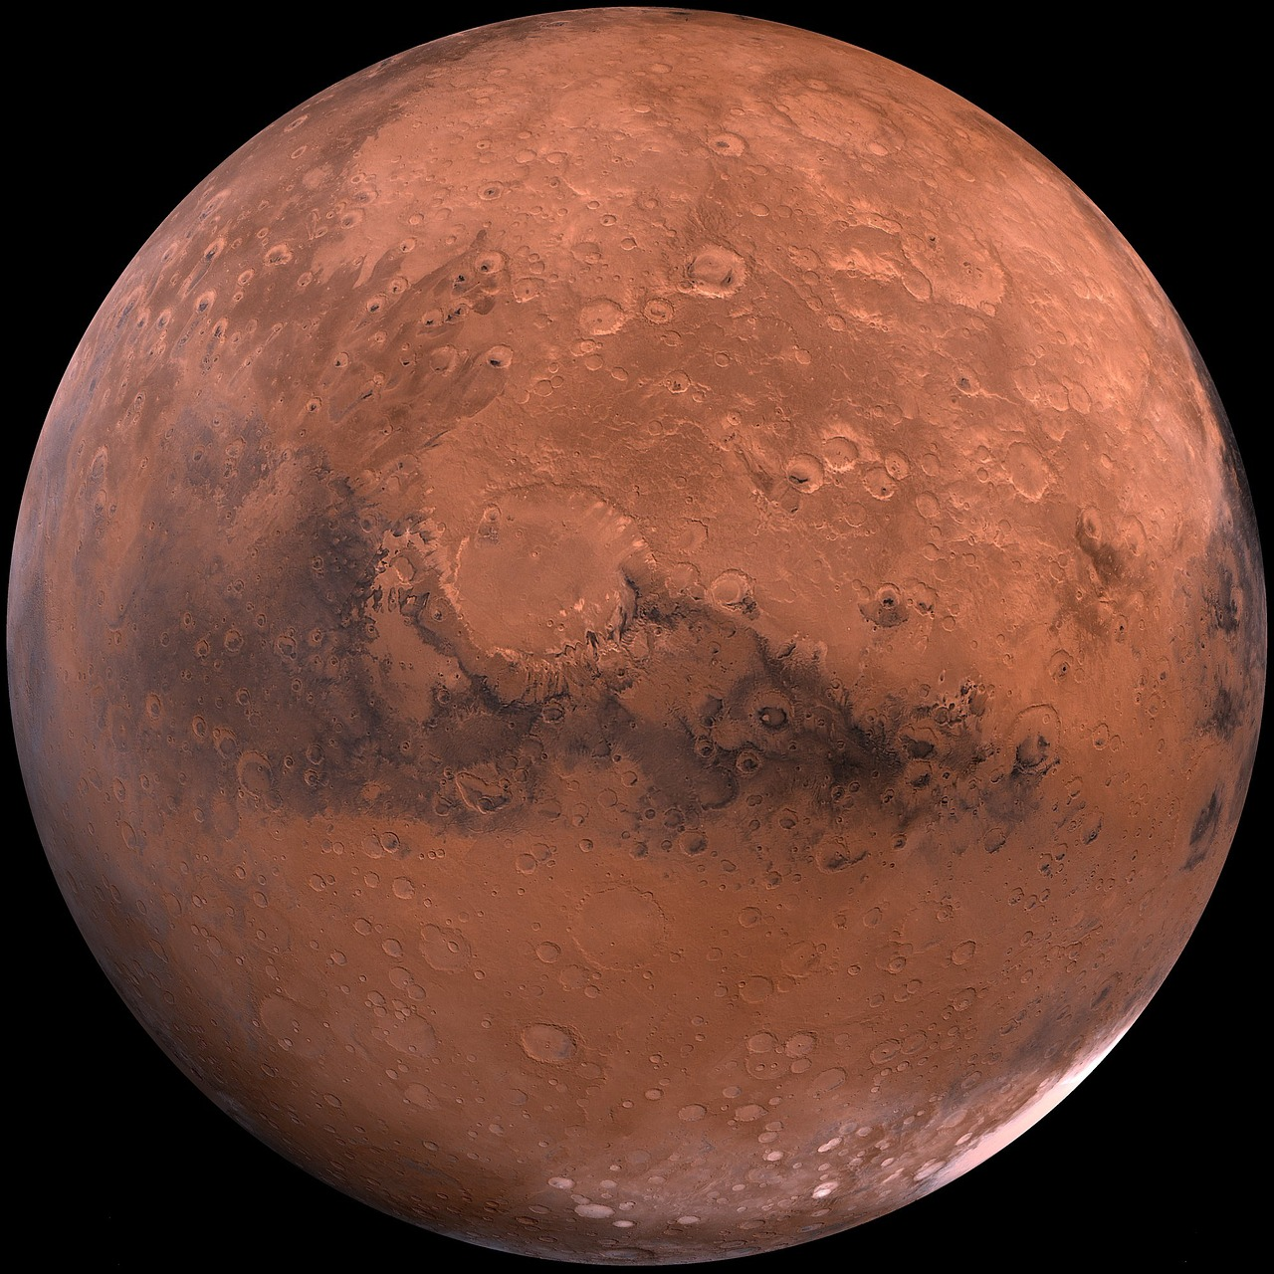

U beddelidda qaabka caadiga ah iyo qaabka jaantuska (standard form)
3) Microchip-ku wuxuu leeyahay ballac dhan 2 × 10−6 m. Ku qor tiro caadi ah (ordinary number) oo ku jirta cm.
4) Mars waxay u jirtaa Dhulka qiyaastii 225 milyan km. Ku qor qaabka jaantuska (standard form) oo ku jirta m.
5) Gacan-wareega (radius) atamka waa qiyaastii
1 × 10−10 m. Ku qor tiro caadi ah (ordinary number) oo ku jirta mm.

Slide 31
Beddelka qaabka caadiga ah iyo qaabka caadiga ah (standard form)
U beddel kuwan soo socda qaabka caadiga ah (standard form):
0.000 000 263
652 000 000
0.005 63
892 000 000 000
0.000 000 000 000 000 3
30 004 000
0.000 300 4
= 2.63 × 10⁻⁷
= 6.52 × 10⁸
= 5.63 × 10⁻³
= 8.92 × 10¹¹
= 3 × 10⁻¹⁶
= 3.000 4 × 10⁷
= 3.004 × 10⁻⁴

Slide 32
Beddelka qaabka caadiga ah iyo qaabka caadiga ah (standard form)
2) U beddel kuwan soo socda tiro caadi ah:
2.31 × 10⁴
6.153 × 10⁻⁵
9.1565 × 10⁻⁶
2.48 × 10⁵
2.48 × 10⁻⁵
3.0065 × 10⁻⁹
= 23 100
= 0.000 061 53
= 0.000 009 156 5
= 248 000
= 0.000 024 8
= 0.000 000 003 006 5

Slide 33

Beddelka qaabka caadiga ah iyo qaabka caadiga ah (standard form)
3) Microchip (microchip) wuxuu leeyahay ballaciisa 2 × 10−6 m. Ku qor tiro caadi ah oo cm ah.
4) Mars (Mars) waxay u jirtaa dhulka qiyaastii 225 milyan km. Ku qor qaabka caadiga ah (standard form) oo m ah.
5) Gacan-dhexe (radius) atamka (atom) wuxuu qiyaas ahaan yahay 1 × 10−10 m. Ku qor tiro caadi ah oo mm ah.
0.000 002 m = 0.000 000 02 cm
225 000 000 km = 225 000 000 000 m = 2.25 × 1011 m
0.000 000 000 1 m = 0.000 000 000 000 1 mm

Slide 34
Qorista tirooyinka yar ee qaabka caadiga ah (standard form)
Qorista tirooyinka aad u yar ee qaabka caadiga ah (standard form)
Beddelka qaabka caadiga ah iyo qaabka caadiga ah (standard form)
Qaabka caadiga ah (standard form) ee kalkuulatar (calculator)

Slide 35
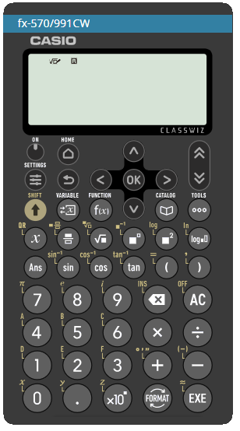
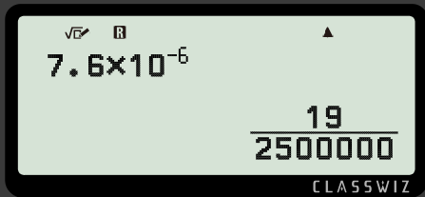




Qaabka caadiga ah (standard form) ee kalkuulatar (calculator)
Aan isku dayno beddelka 7.6 × 10−6 oo tiro caadi ah
Isticmaal gelinta (input)
Riixida ama
Dooro oo u beddel jajab tobanle (decimal)
Maxaa dhacaya?

Slide 36
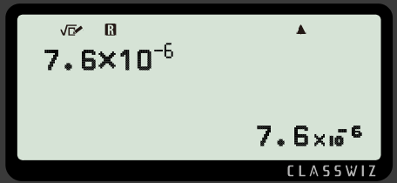
Qaabka caadiga ah (standard form) ee xisaabiyaha (calculator)
Ma beddeli doono jajab tobanle (decimal).
Waxay jawaabta ku hayaa qaabka caadiga ah (standard form) sababtoo ah jawaabtu aad bay u yar tahay.
Sidaa darteed waxaa muhiim ah inaad awood u leedahay inaad u beddesho qaabka caadiga ah (standard form) tiro caadi ah (ordinary number).
Waa maxay tan marka loo eego tiro caadi ah (ordinary number)?
0.000 007 6

Slide 37

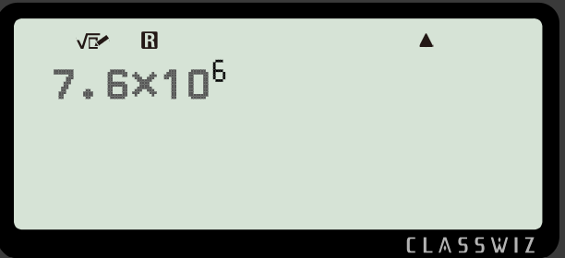
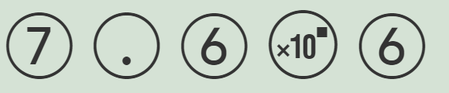

Qaabka caadiga ah (standard form) ee xisaabiyaha (calculator)
Waxaad sidoo kale isticmaali kartaa badhanka
Isticmaalka gelinta (input)
Riixida ama
Dooro oo u beddel tobanle (decimal)
Soo-saarka (output) wuxuu noqon doonaa mid la mid ah

Slide 38
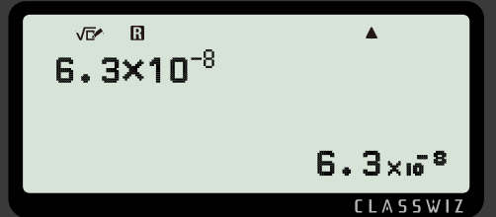
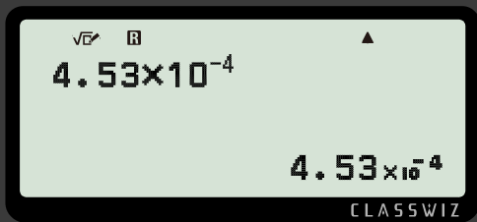
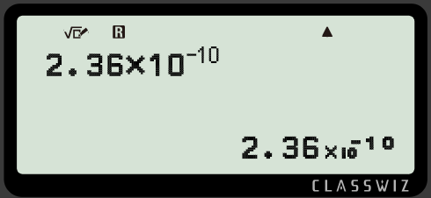
Qaabka caadiga ah (standard form) ee xisaabiyaha (calculator)
Ku qor kuwan soo socda qaab tobanle (decimal).
0.000 000 063
0.000 453
0.000 000 000 236

Slide 39
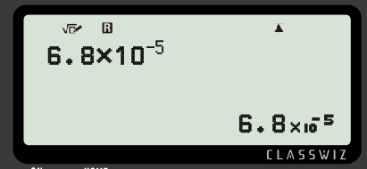
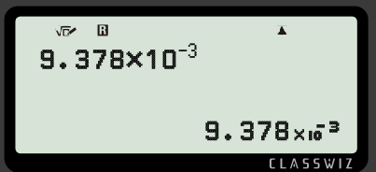
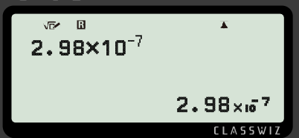
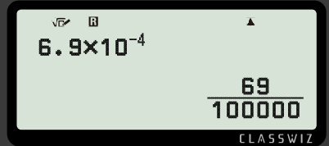
Qaabka caadiga ah (standard form) ee xisaabiyaha (calculator)
Ku qor soo-saarka (output) qaab tobanle (decimal).
a)
c)
b)
d)

Slide 40
Qaabka caadiga ah (standard form) ee xisaabiyaha (calculator)
2) Baadh goorta tirada noqoto mid aad u yar oo xisaabiyuhu (calculator) u beddelo qaabka caadiga ah (standard form).

Slide 41
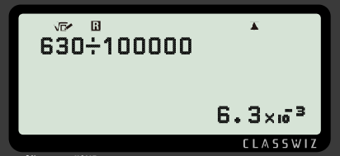
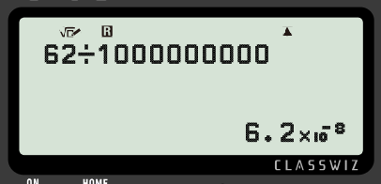
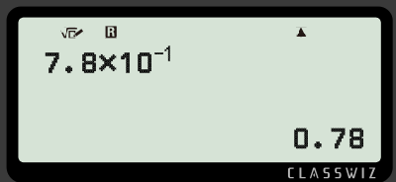
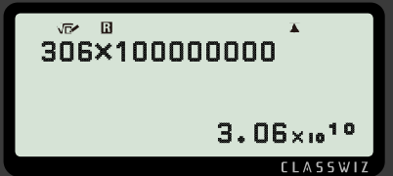
Qaabka caadiga ah (standard form) ee xisaabiyaha (calculator)
3) Buuxi macluumaadka maqan.
a)
c)
b)
d)

Slide 42
Qaabka caadiga ah (standard form) ee xisaabiyaha (calculator)
Ku qor soo-saarka (output) qaab tobanle (decimal).
a)
c)
0.000 068
0.009 378
b)
d)
0.000 000 298
0.000 69

Slide 43
Qaabka caadiga ah (standard form) ee xisaabiyaha (calculator)
2) Baadh goorta tirada noqoto mid aad u yar oo xisaabiyuhu (calculator) u beddelo qaabka caadiga ah (standard form).
Tiro kasta oo loo qoro qaabka caadiga ah (standard form) wuxuu leeyahay jibbaar (exponent) ka yar ama la eg −3

Slide 44
Qaabka caadiga ah (standard form) ee xisaabiyaha (calculator)
3) Buuxi macluumaadka maqan.
a)
c)
b)
d)

Slide 45
Qorista tirooyinka yaryar ee qaabka caadiga ah (standard form)
Waa cad in loo baahan yahay qaabka caadiga ah (standard form) nolosha dhabta ah, marka waa muhiim in tirooyinka aad u waaweyn ama aad u yaryar lagu qoro qaabka caadiga ah (standard form) iyo lidkeeda.
A × 10n halkaas oo 1 ≤ A < 10 iyo n uu yahay tiro dhammaystiran (integer).
A waa inuu ahaadaa tiro u dhaxaysa 1 iyo 10, oo ay ku jirto 1 lamana aha 10
n wuxuu noqon karaa tiro dhammaystiran (integer) togan ama taban.
Marka jibbaarku (exponent), n, uu yahay togan, tirada guud waa weyn tahay. Marka jibbaarku (exponent), n, uu yahay taban, tirada guud waa yar tahay.

